Slide 1
In Fill Gain Corrections: E/p vs Laser Sam Grant 23th July 2019

Slide 2
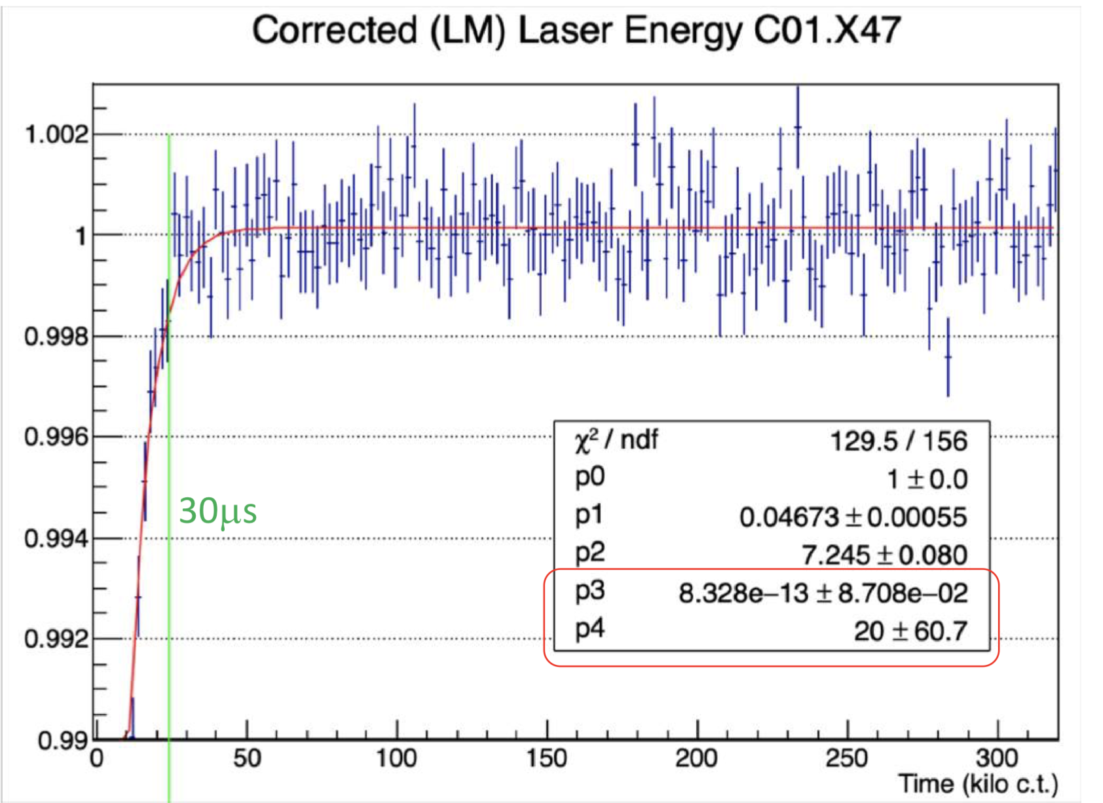
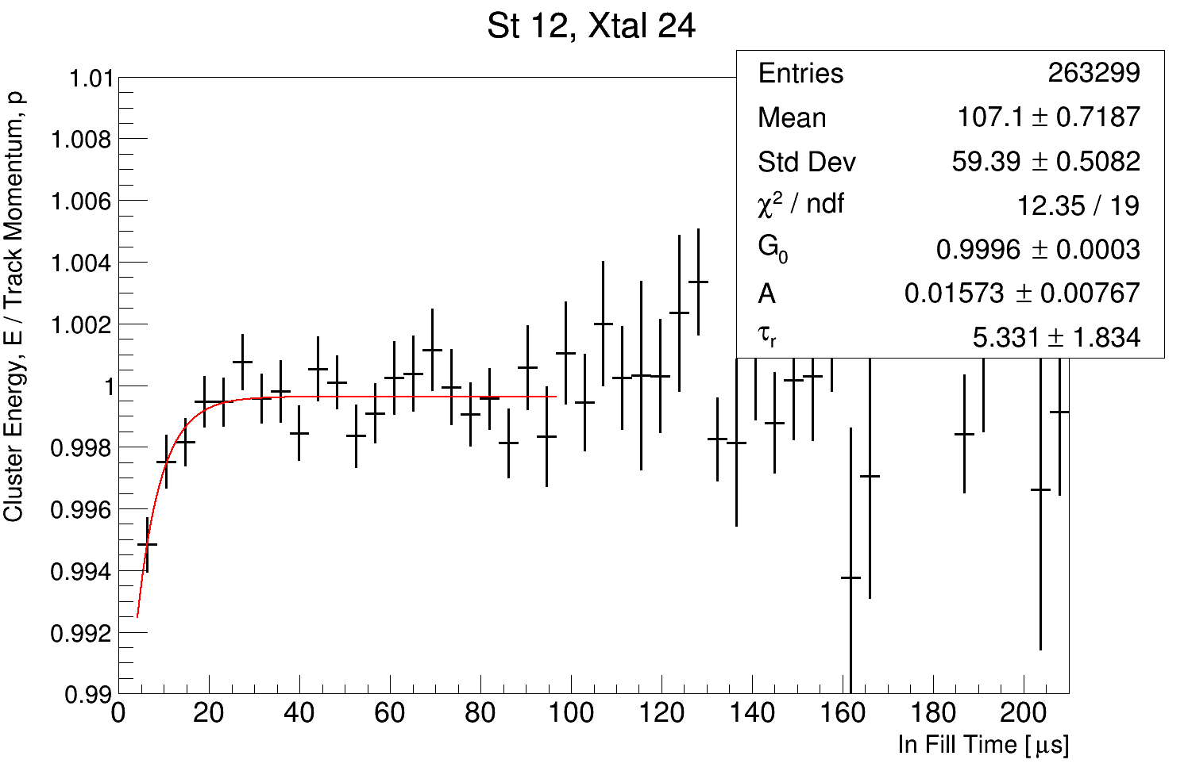
Aim
1. Measure the in fill gain parameters using the E/p ratio (track-calo matched hits)
2. Quantify the level of deviation between laser and E/p
Laser example
E/p example

Slide 3
Problem: Statistics Limited
I’ve been struggling with low statistics per crystal, especially near the calo edges
You need as many tracks as possible or else you get rubbish like this:

Slide 4
Problem: Statistics Limited
I’ve been struggling with low statistics per crystal, especially near the calo edges
You need as many tracks as possible* or else you get rubbish like this:
*without comprising track quality

Slide 5
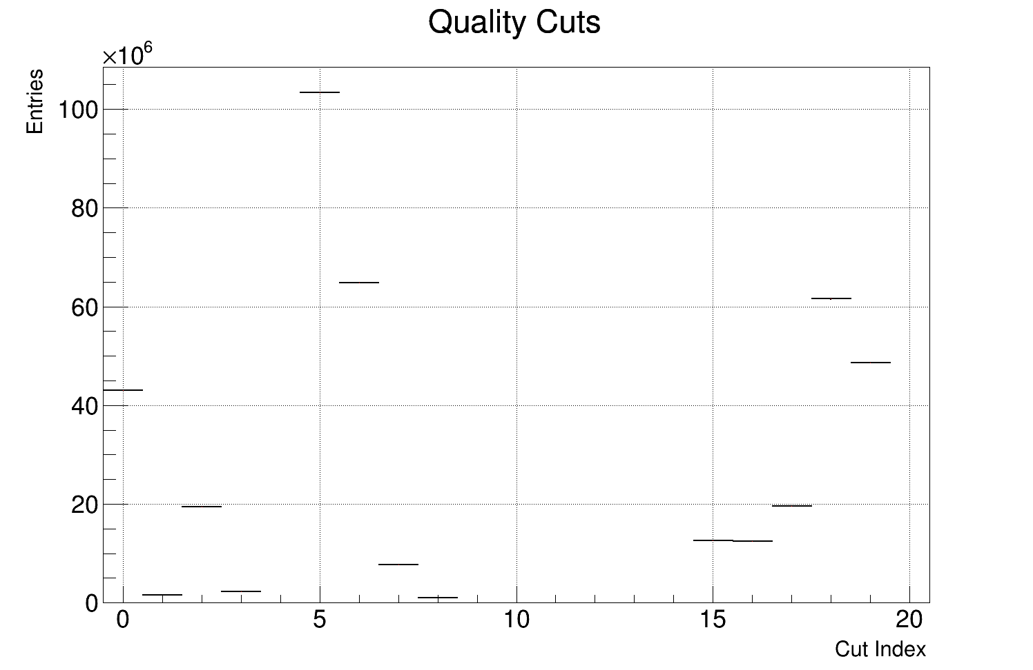
Solution: Loosen Quality Cuts
Here are the quality cuts where we lose tracks:
0. Number of hits (total and U/V)
| u - v | hits <= 4
Fraction of missed layers
Drift time
Non failed track
P value
Track residuals < 500 um
Track entrance x window
Track entrance y window
Non failed vertex
No volumes hit
Vertex uncertainty R
Vertex uncertainty Y
Extrapolation distance forwards
Extrapolation distance backwards
Time difference 12
Time difference 18
Radial difference
Energy window
Positron log(E/p)
Lost muon log(E/p)

Slide 6
Quality Cuts
Good track cuts: either quite small or too important
0. Number of hits (total and U/V)
| u - v | hits <= 4
Fraction of missed layers
Drift time
Non failed track
P value
Track residuals < 500 um
Track entrance x window
Track entrance y window
Non failed vertex
No volumes hit
Vertex uncertainty R
Vertex uncertainty Y
Extrapolation distance forwards
Extrapolation distance backwards
Time difference 12
Time difference 18
Radial difference
Energy window
Positron log(E/p)
Lost muon log(E/p)

Slide 7
Quality Cuts
Good vertex cuts: were never switched on anyway
0. Number of hits (total and U/V)
| u - v | hits <= 4
Fraction of missed layers
Drift time
Non failed track
P value
Track residuals < 500 um
Track entrance x window
Track entrance y window
Non failed vertex
No volumes hit
Vertex uncertainty R
Vertex uncertainty Y
Extrapolation distance forwards
Extrapolation distance backwards
Time difference 12
Time difference 18
Radial difference
Energy window
Positron log(E/p)
Lost muon log(E/p)

Slide 8
Problem: Statistics Limited
Good track-calo matching cuts: energy window cut the is least important and most aggressive
0. Number of hits (total and U/V)
| u - v | hits <= 4
Fraction of missed layers
Drift time
Non failed track
P value
Track residuals < 500 um
Track entrance x window
Track entrance y window
Non failed vertex
No volumes hit
Vertex uncertainty R
Vertex uncertainty Y
Extrapolation distance forwards
Extrapolation distance backwards
Time difference 12
Time difference 18
Radial difference
Energy window
Positron log(E/p)
Lost muon log(E/p)

Slide 9
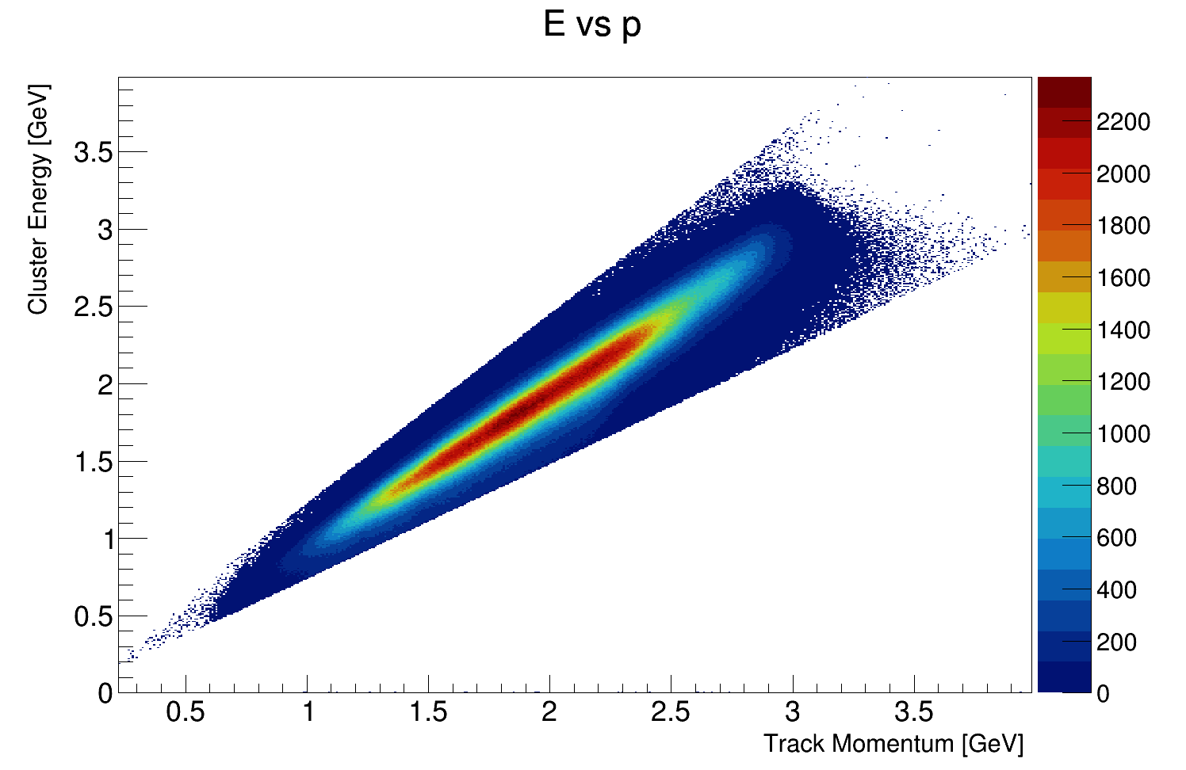
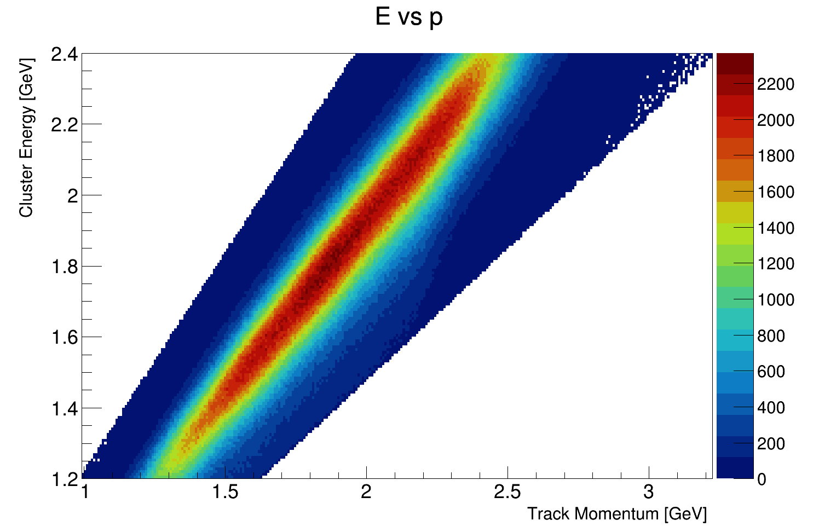
Energy window Cut
Originally intended to get the purest possible positron sample

Slide 10
Energy window Cut
I think it’s excessive, let’s drop it

Slide 11
Fit quality
I still need some kind of quality control on the fits themselves, here’s what I use:
if (quality) {
// Avoid low stats
if (N < 100000) continue;
// Require a reasonable reduced chi square
if( chiSqrNDF < 0.25 || chiSqrNDF > 4) continue;
// Require low relative error
if( tau_err > 0.5*tau || A_err > 0.5*A) continue;
// Get rid of infinite errors please!
if( isnan(tau_err) == true || isnan(A_err) == true ) continue;
// Chop anything a factor of 100 greater than the expectation
if(tau > 100 || A > 1) continue;
}

Slide 12
Fit range
Where is the optimum place to stop the fit?
Too early and the fit makes no sense
Too late and we’re fitting to increasingly low stat bins
-> Scan across fit range, plotting the fit parameters and their uncertainties. Then pick a reasonable fit end point…

Slide 13
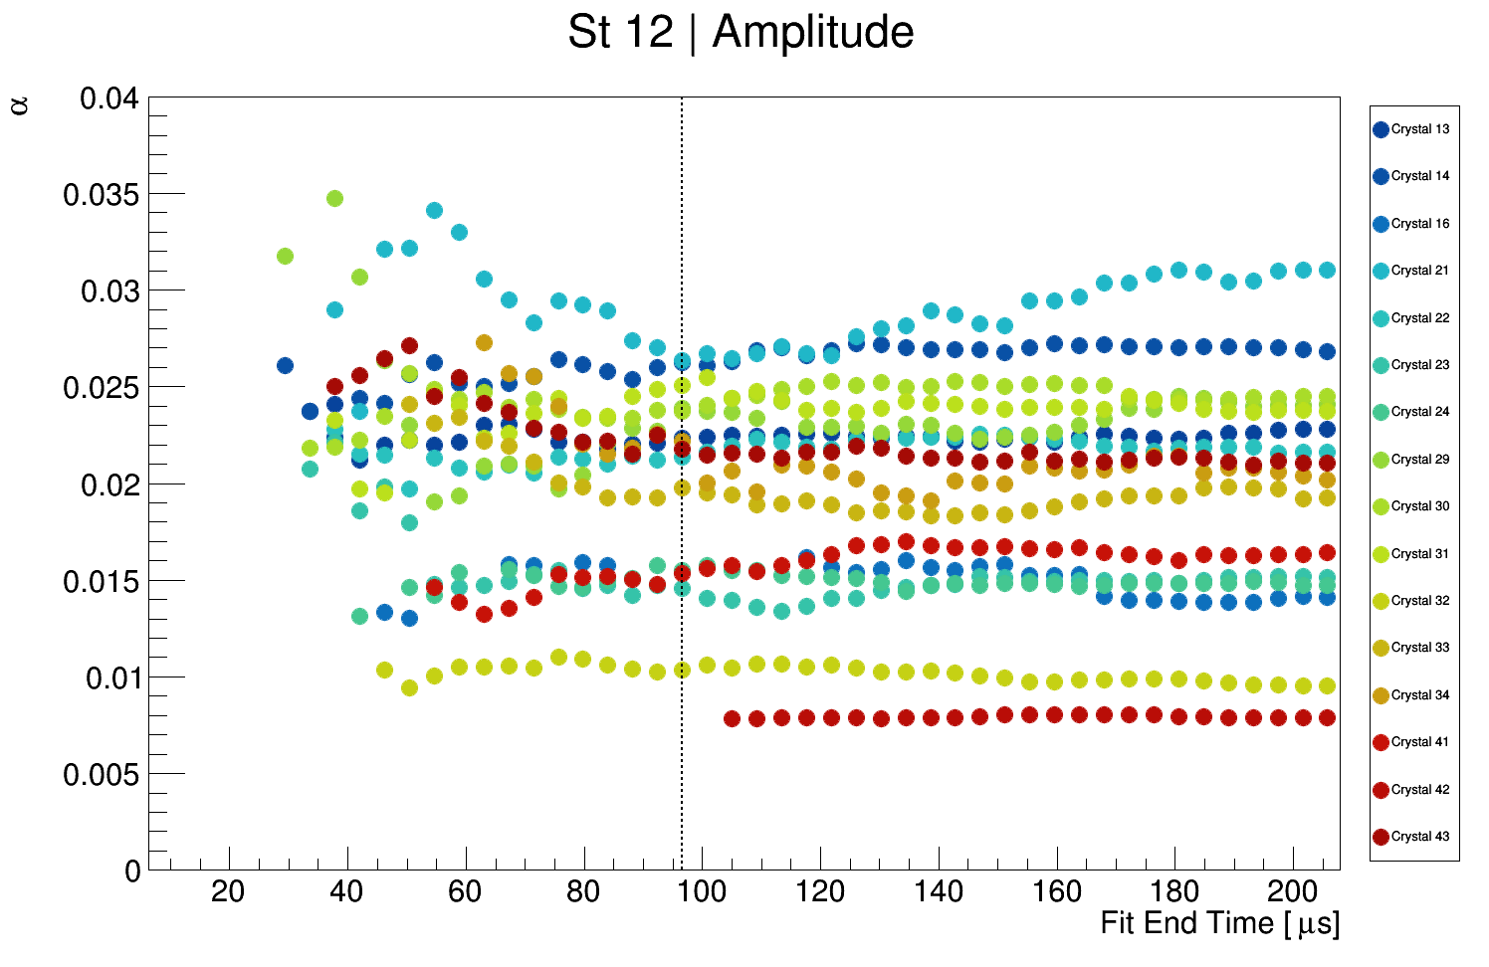
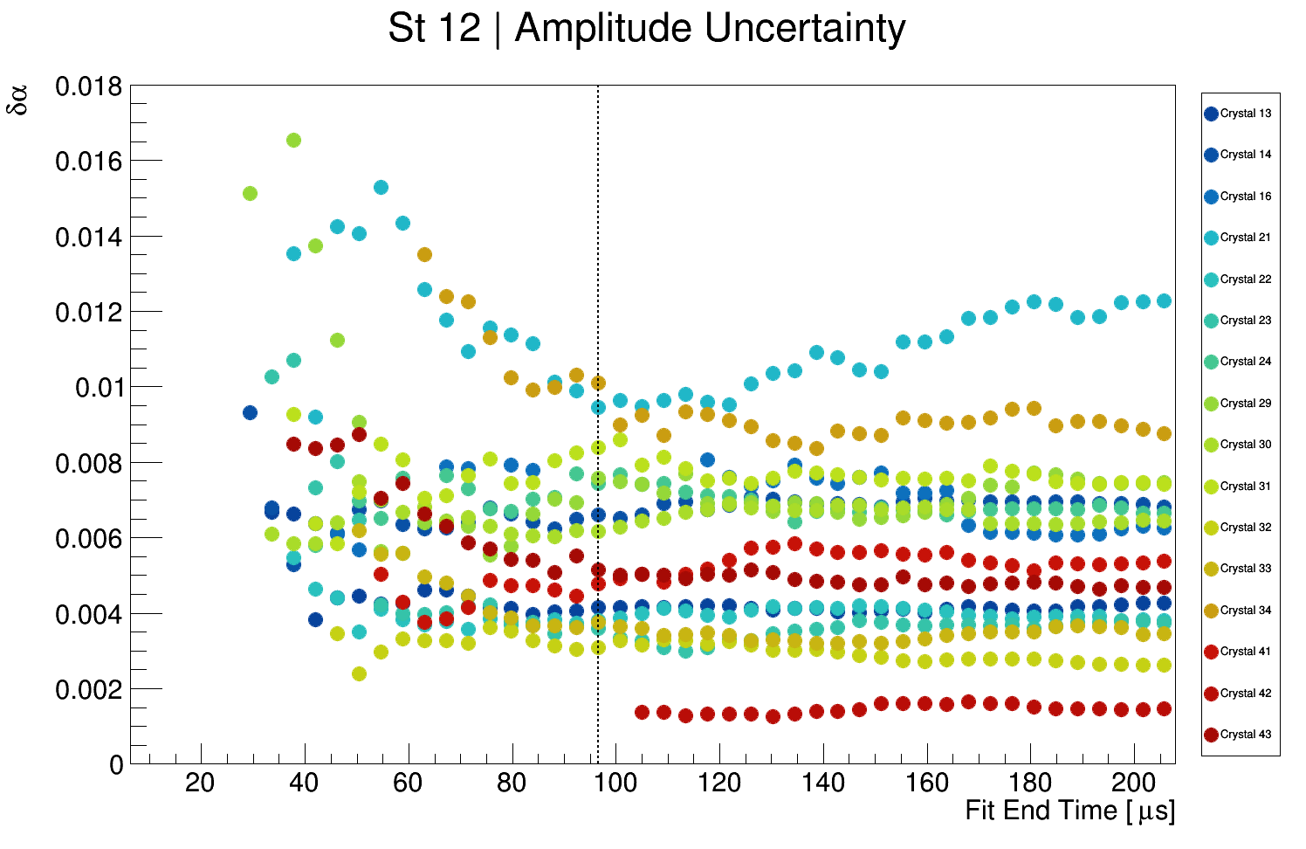
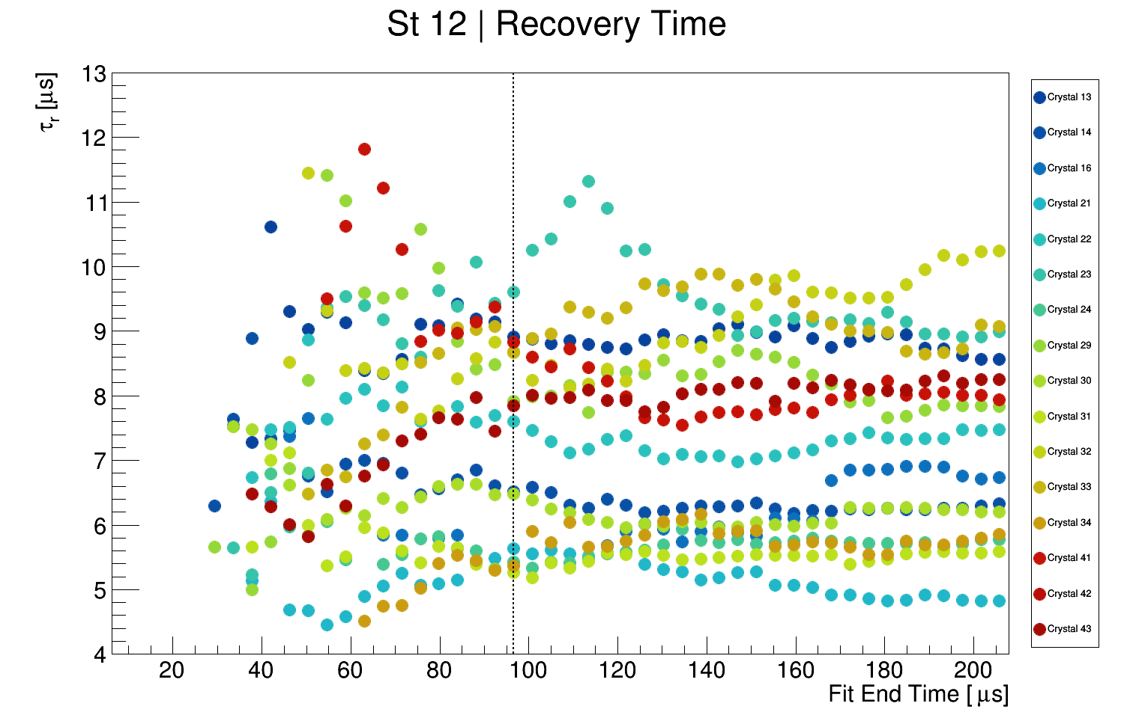
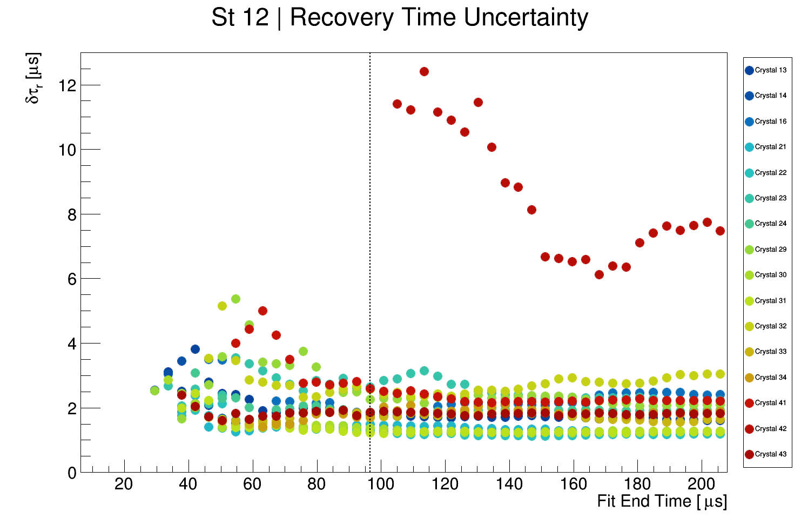
Fit range (Station 12)
Vertical line: the end point I choose.

Slide 14
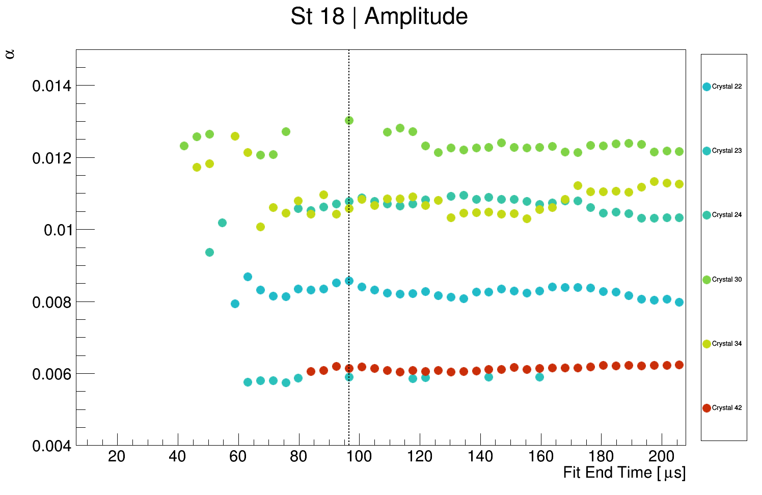
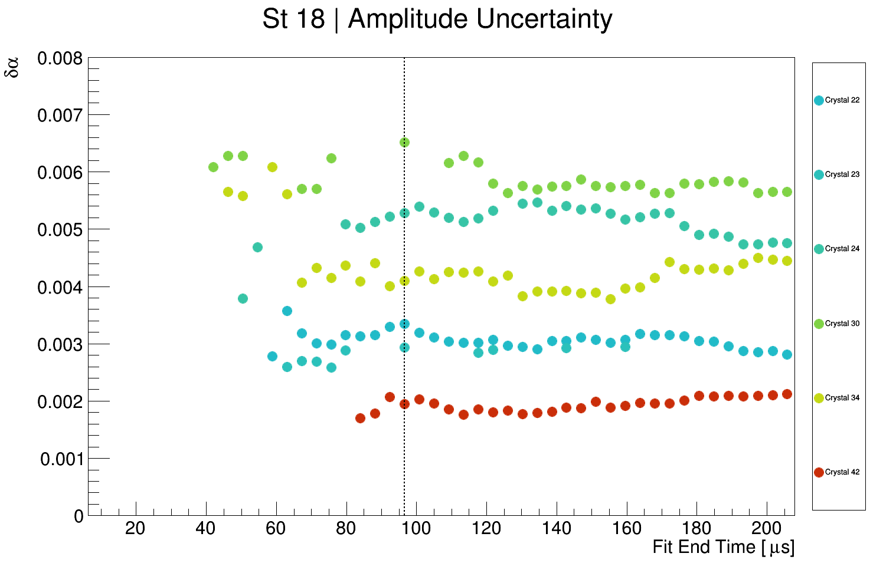
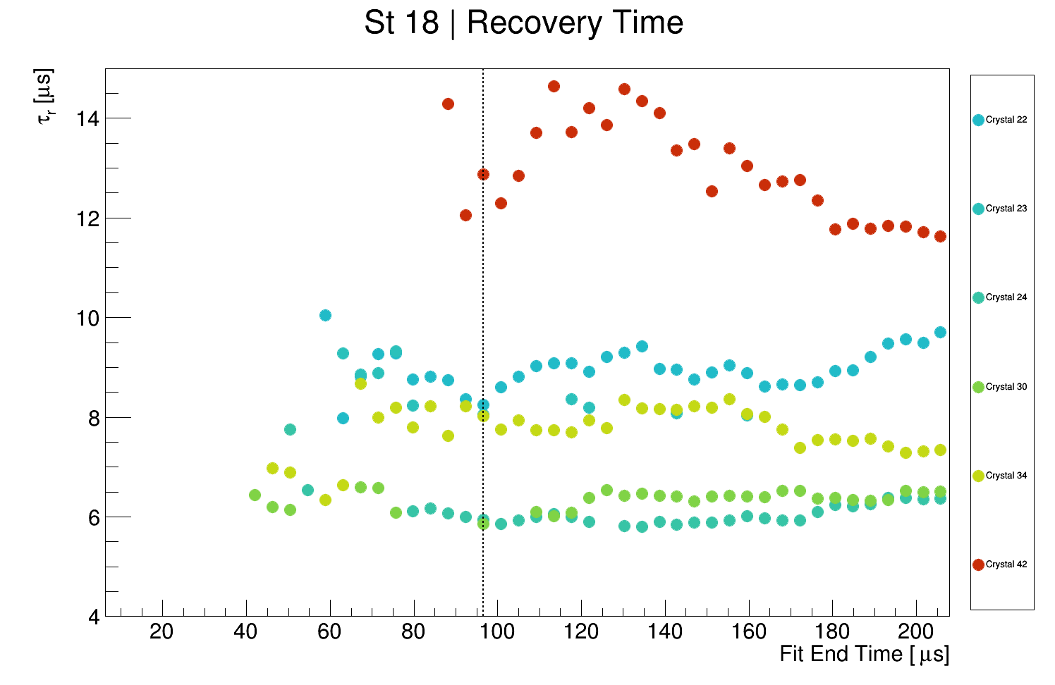
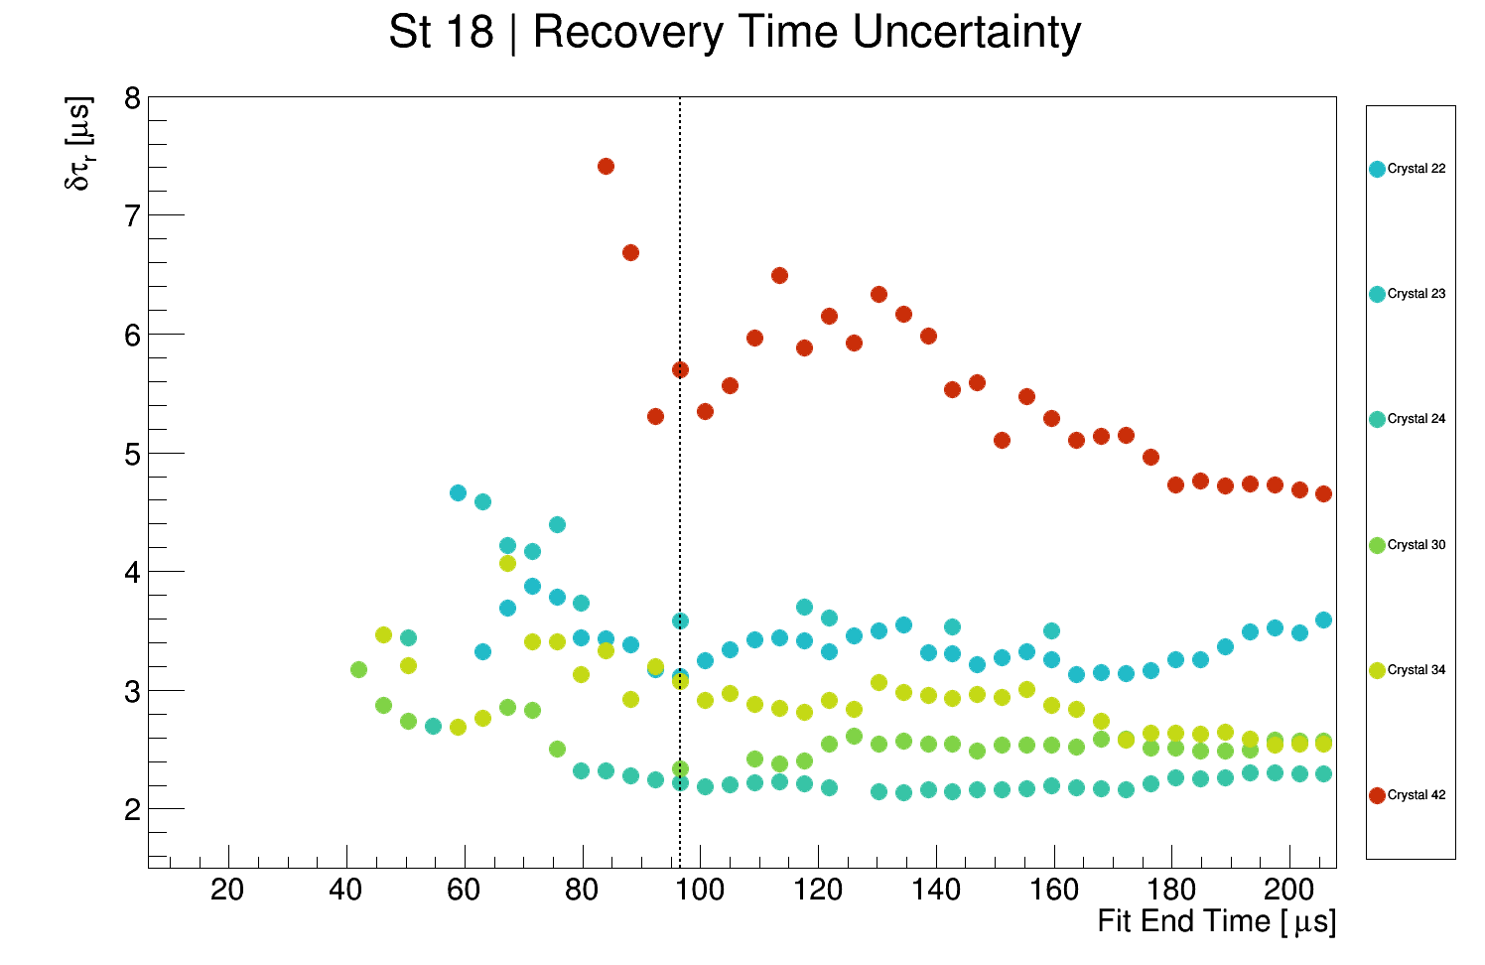
Fit range (Station 18)
Vertical line: the end point I choose.

Slide 15

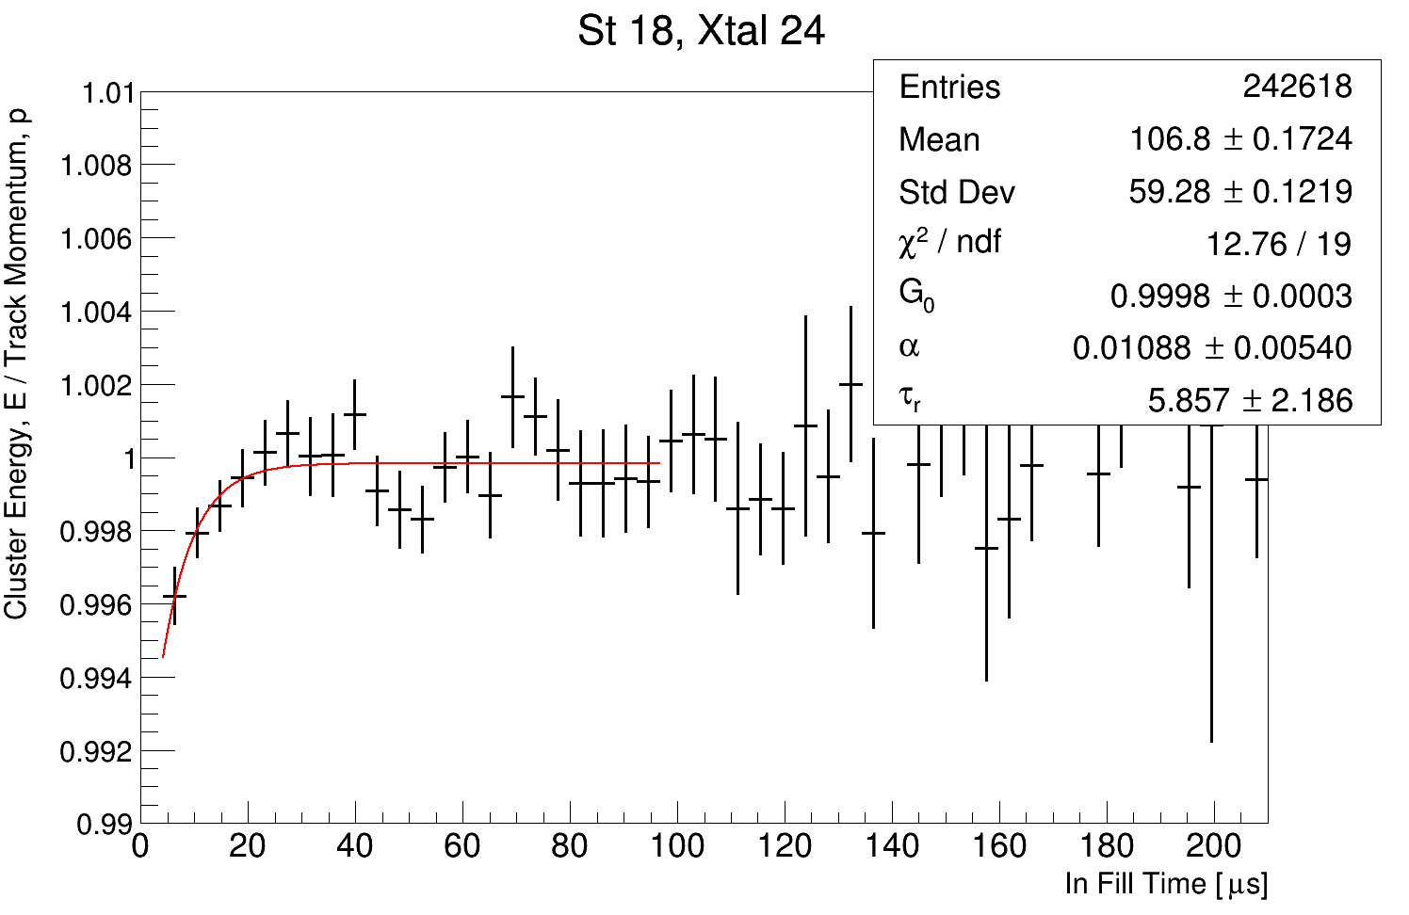
Example Fits
18 crystals survive in total, 14 of them from station 12

Slide 16
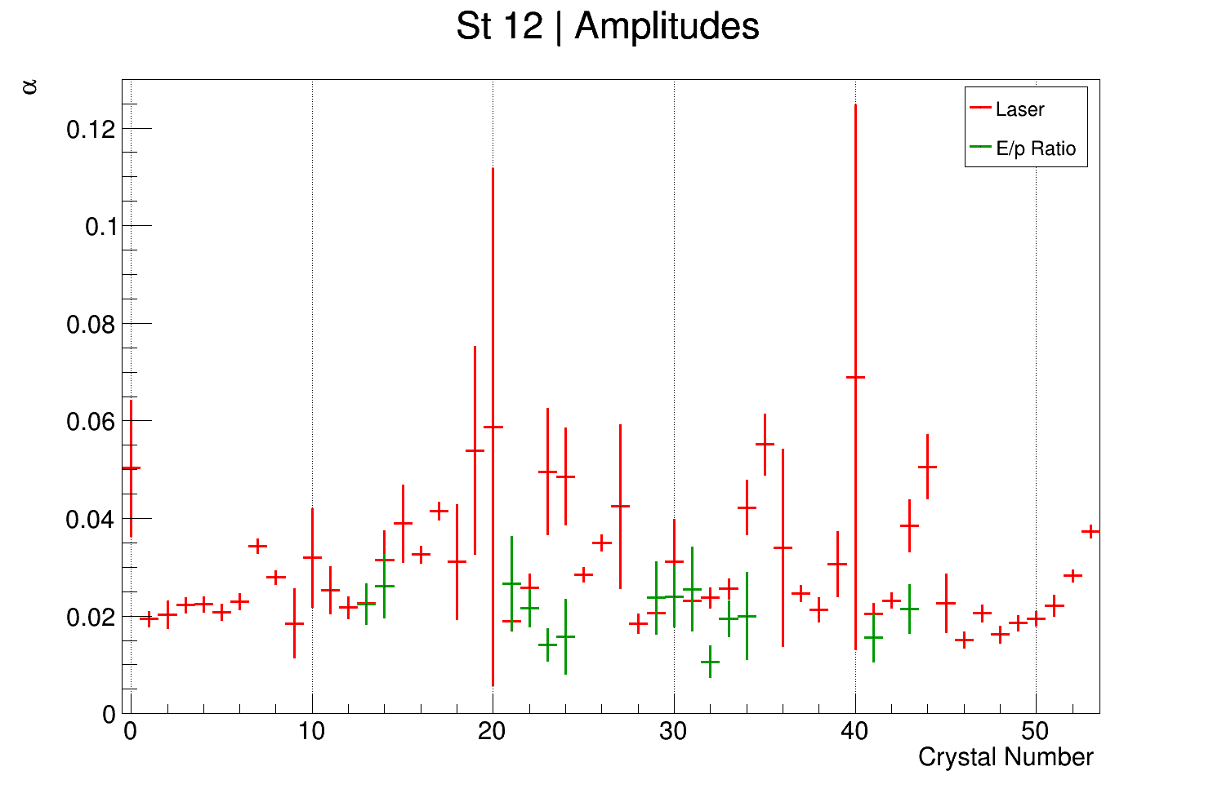
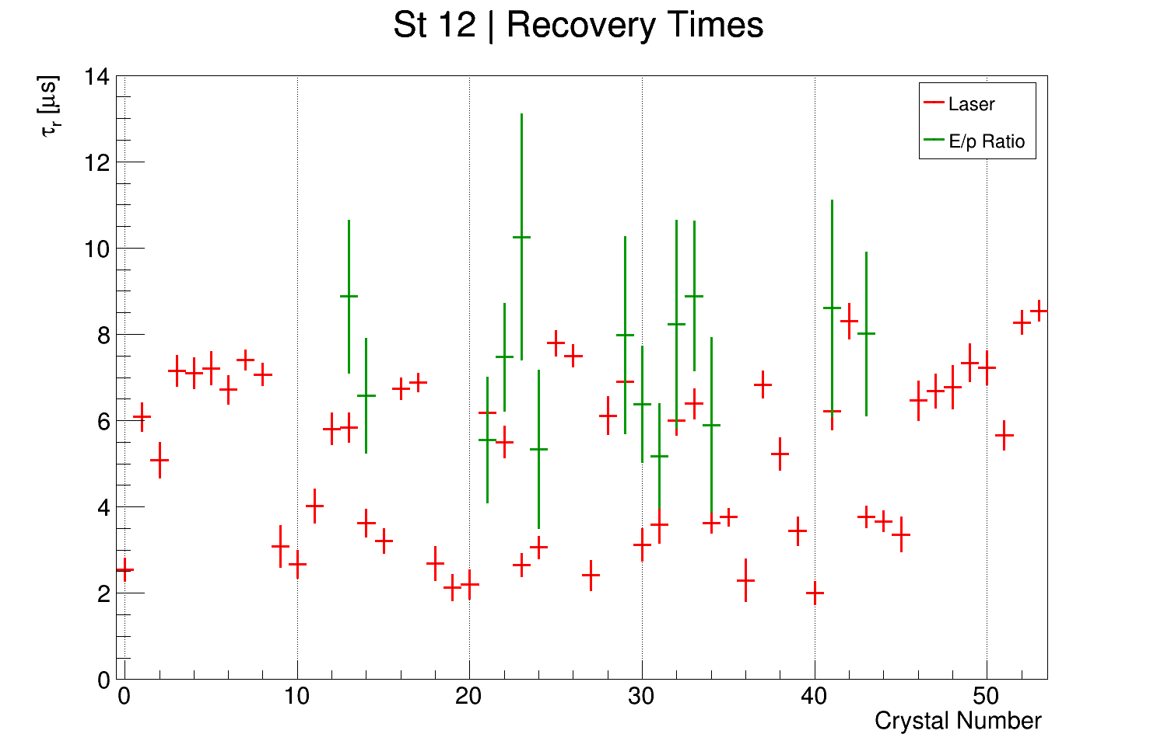
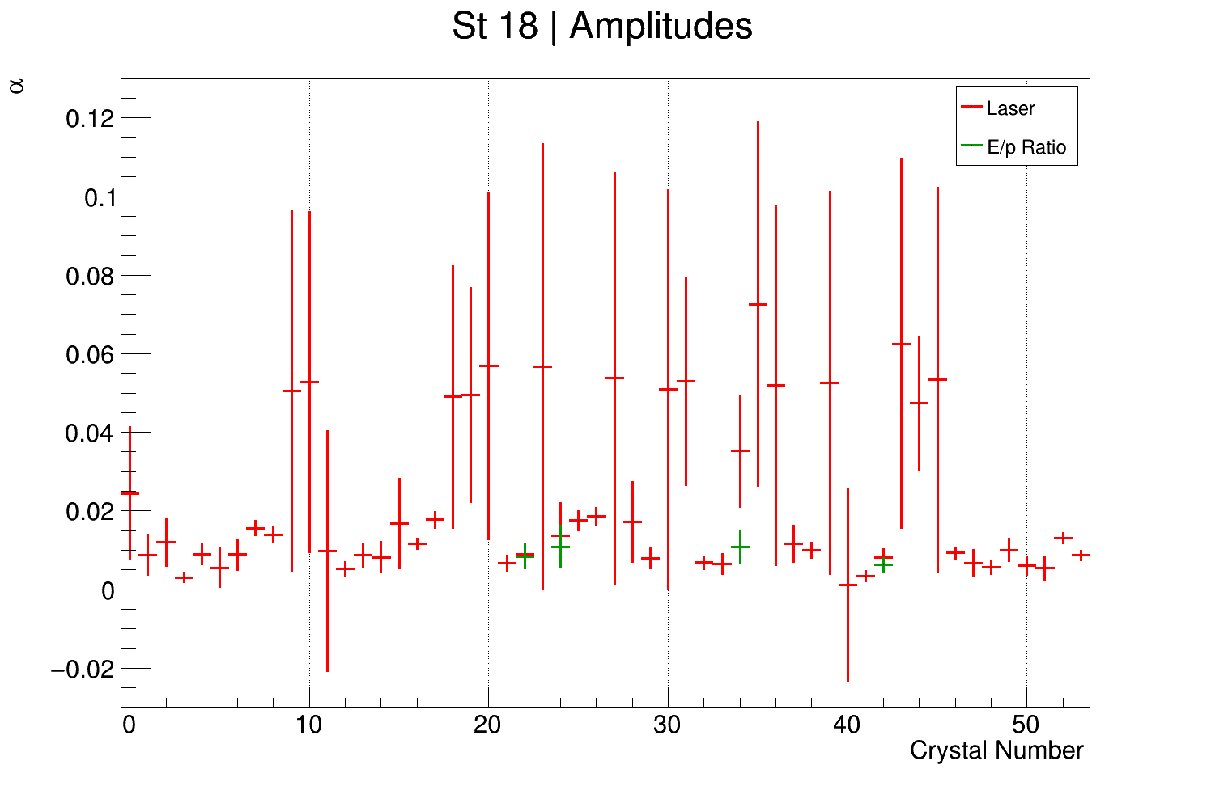
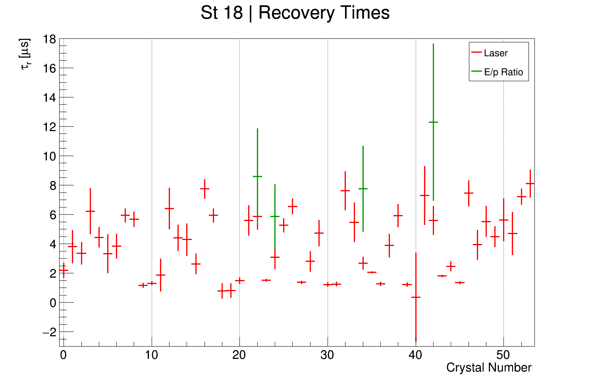
Comparison between E/p and laser parameters

Slide 17
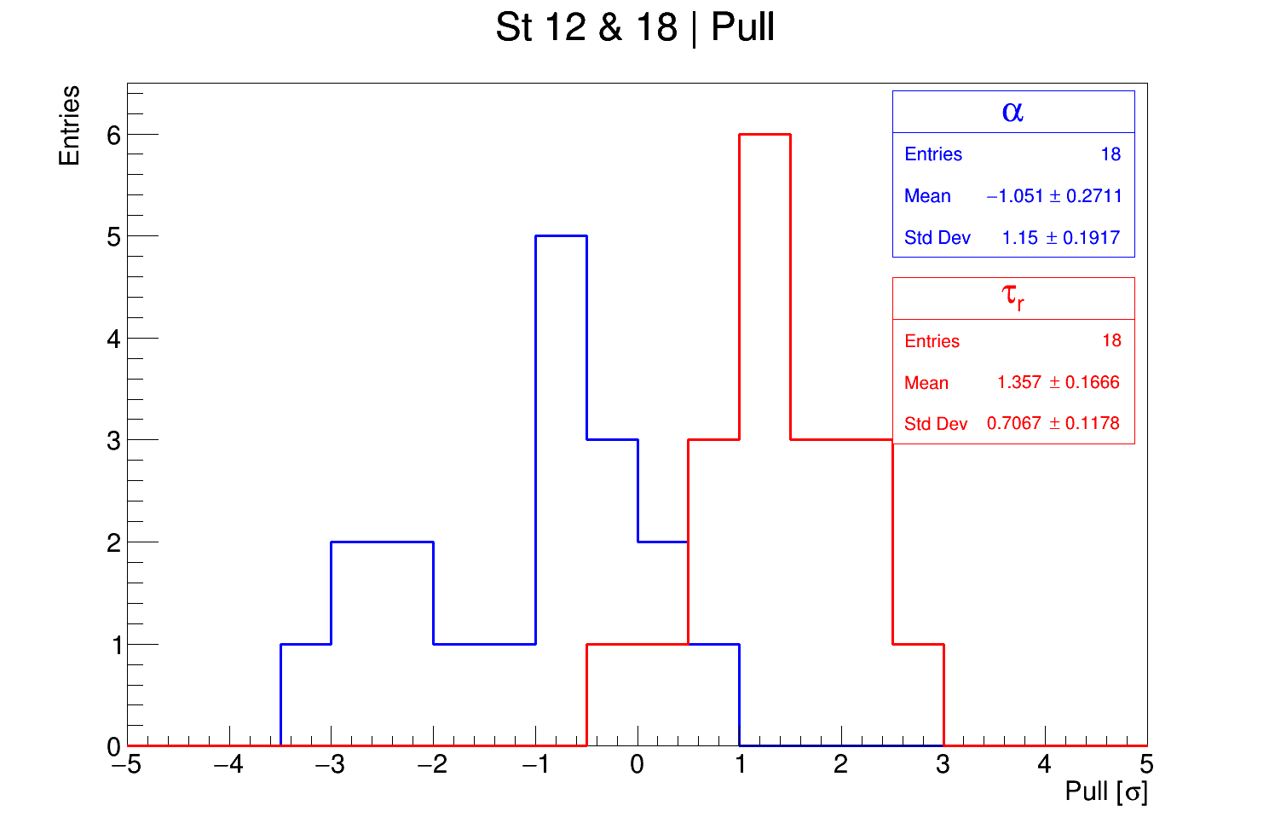
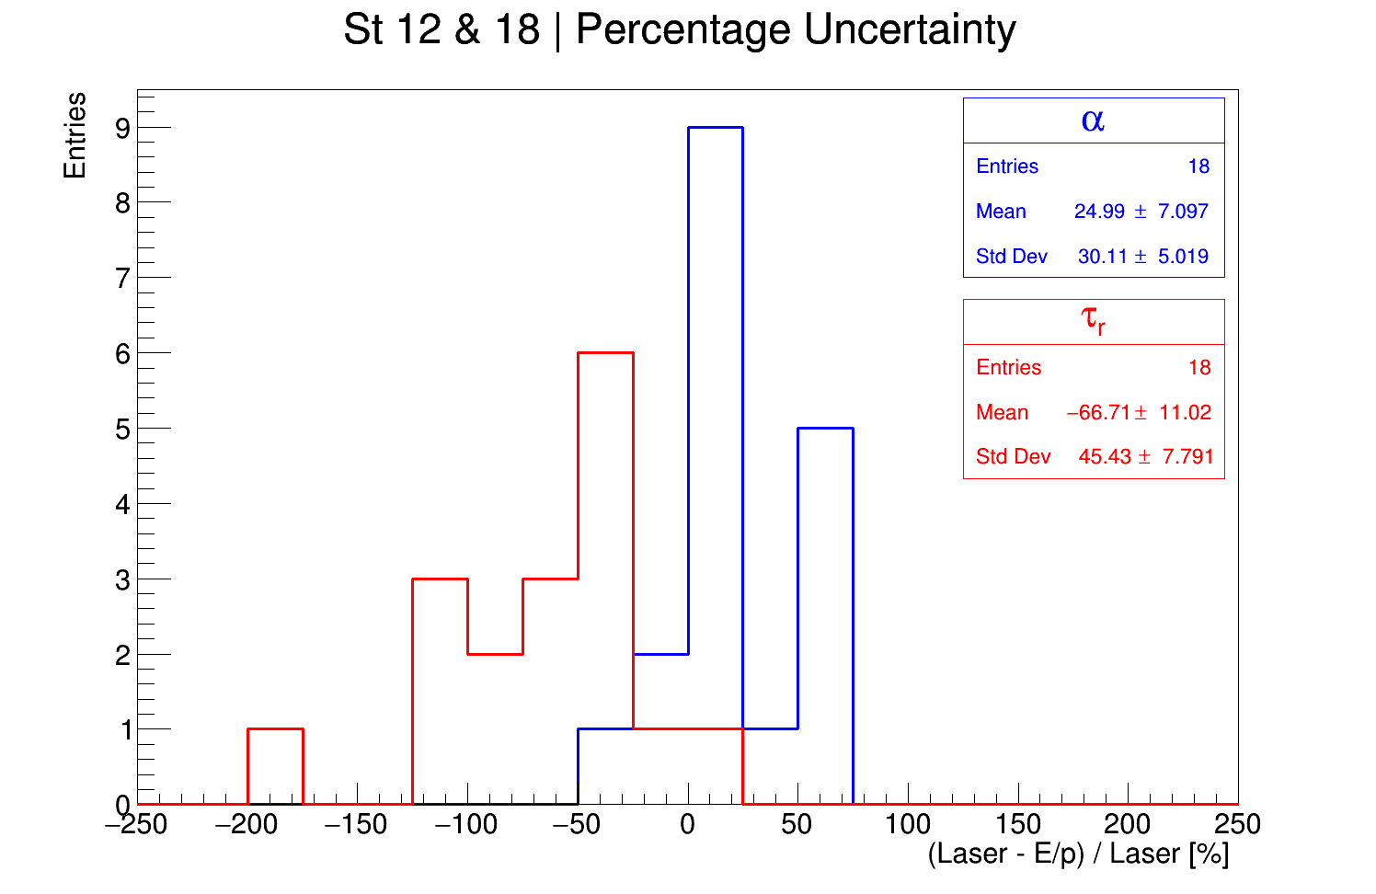
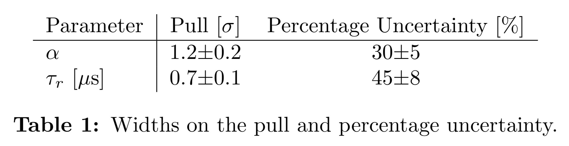
Quantifying the deviation between E/p and laser

Slide 18
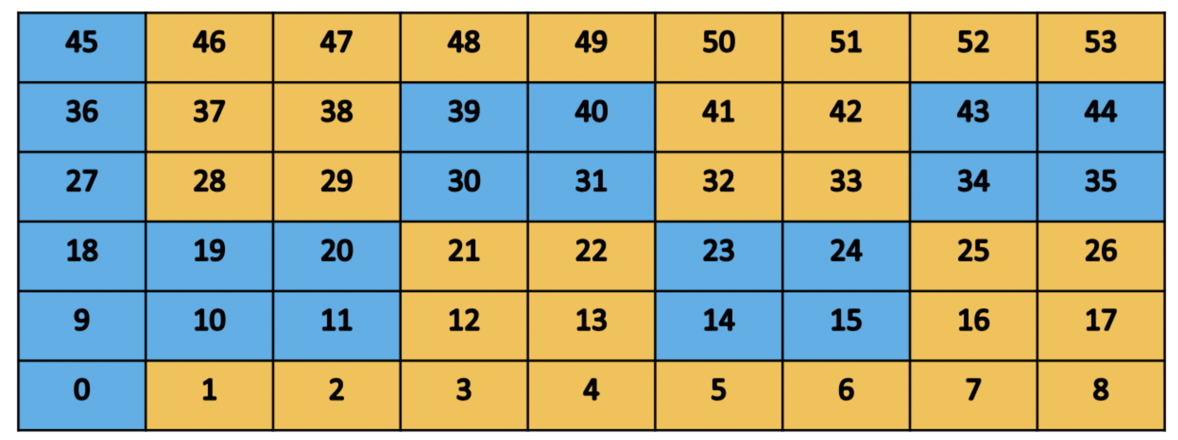
Rinse and repeat: by breakout board
You can group together crystals to get higher stats, but…
You need to separate the crystals by breakout board
You must also normalize every crystal by it’s mean E/p (after 60 µs)
Longer lifetime, shorter lifetime

Slide 19
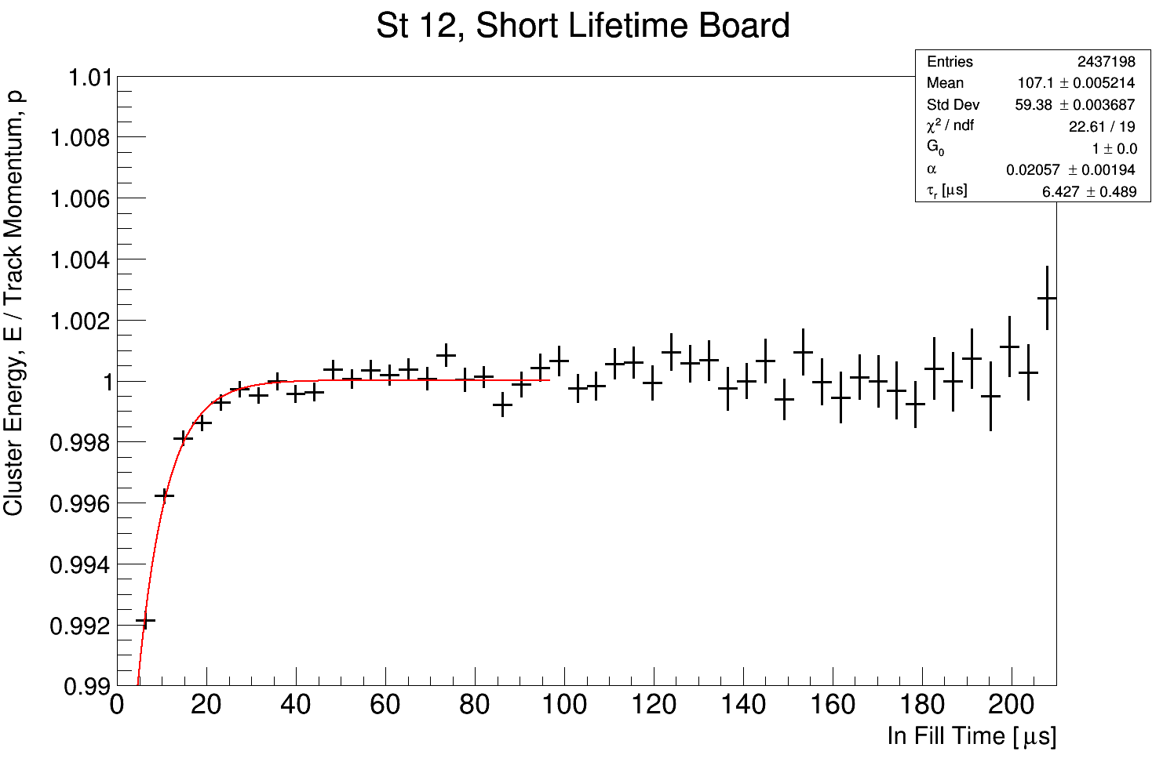
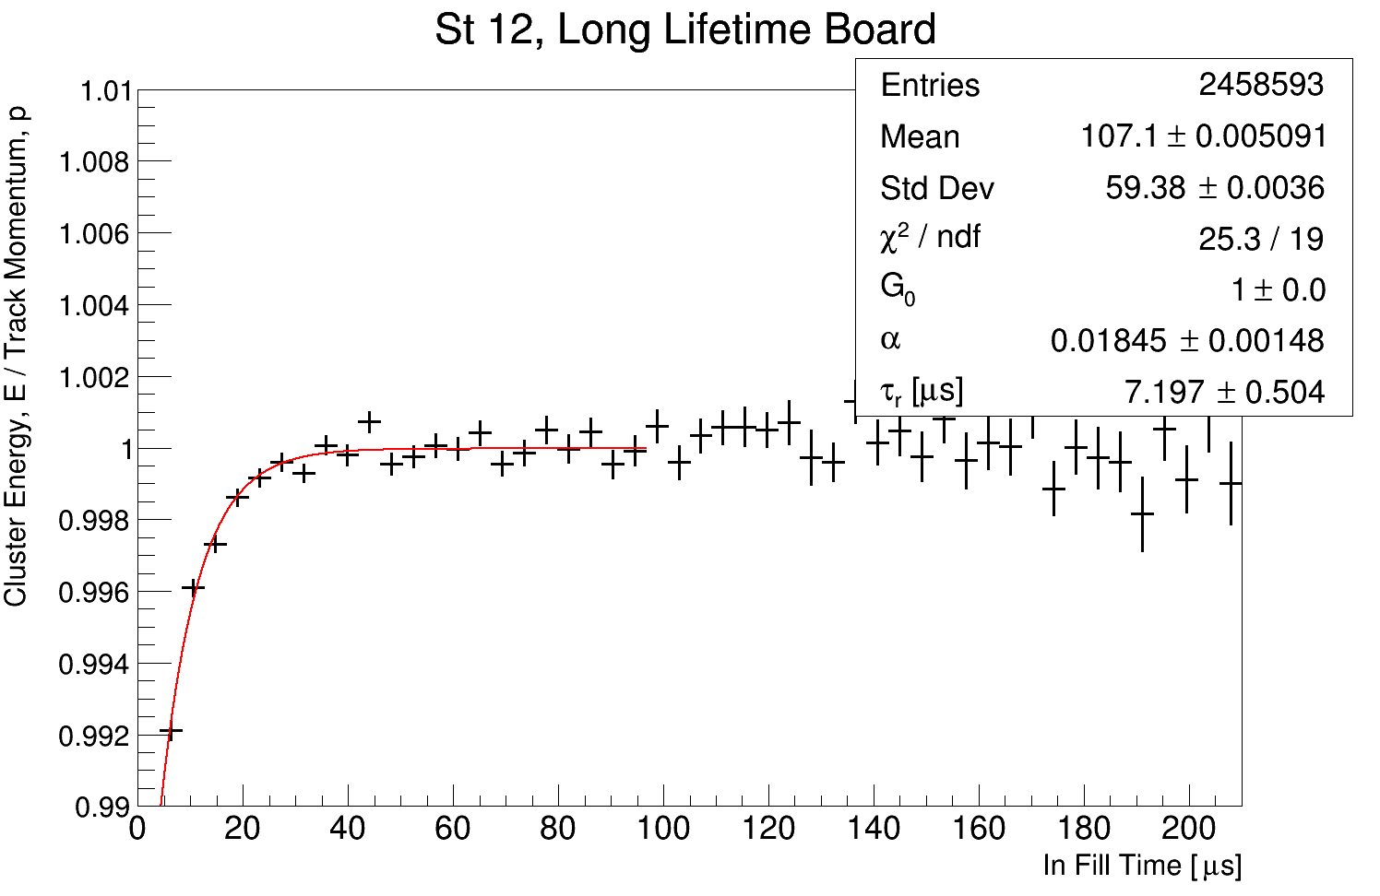
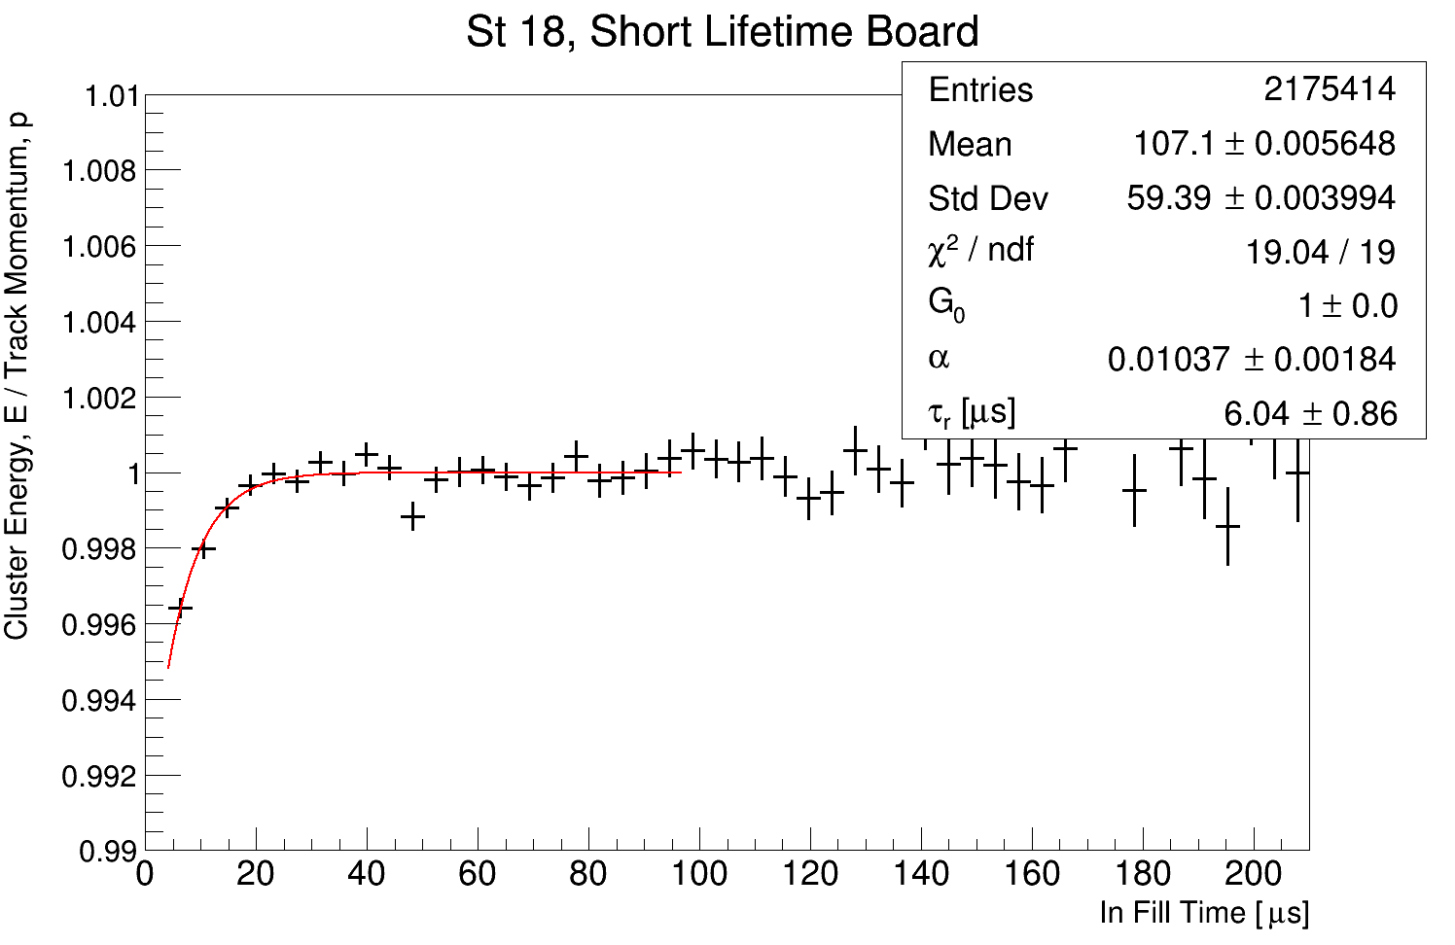
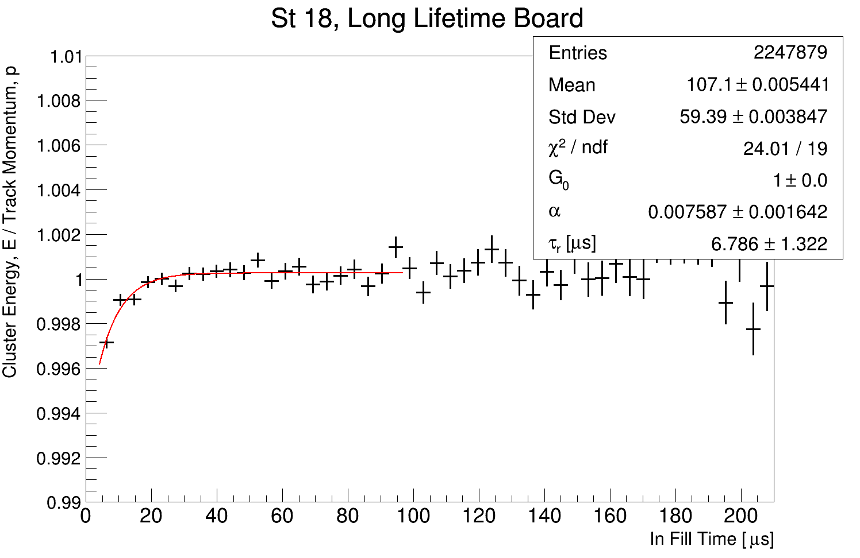
Rinse and repeat: by breakout board

Slide 20
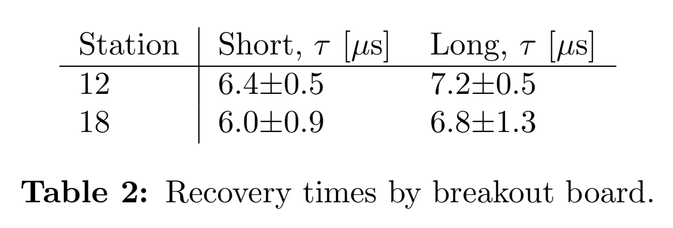
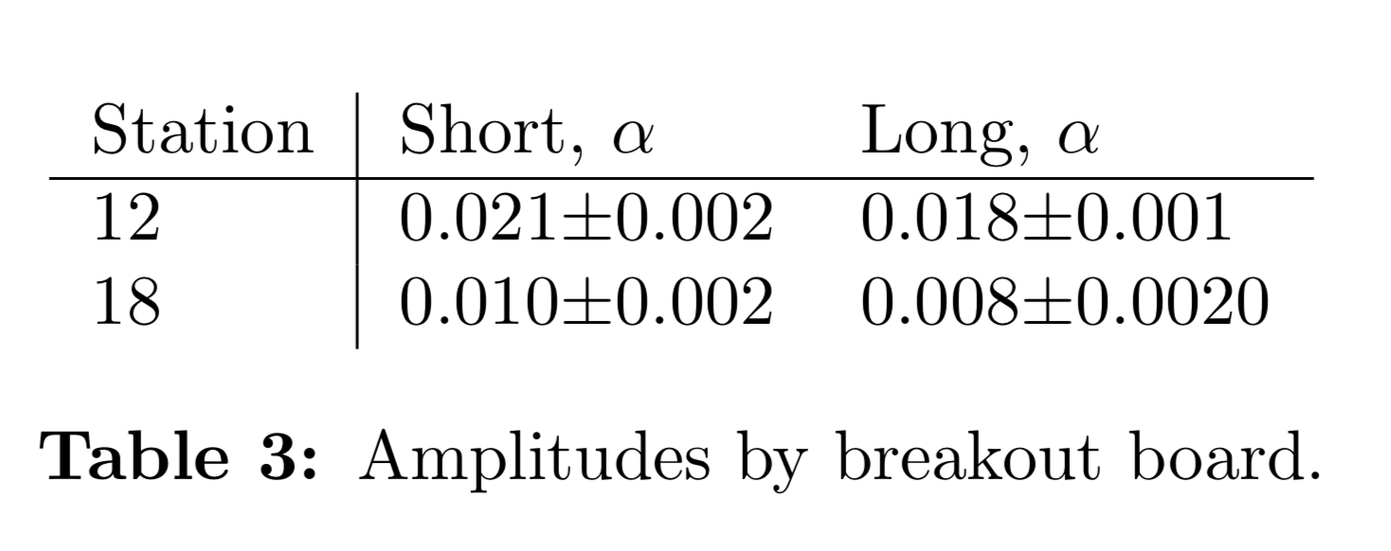
Rinse and repeat: by breakout board
A believable result... Also, remember that station 18 is further from the inflector, and so is less affected by the splash/flash

Slide 21
Summary
My results are consistent with the laser
I can estimate the percentage uncertainty on the IFG parameters (an attempt at coming up with a useful systematic from this study)
I need to run over the bigger data sets (this is all 60 hour)

Slide 22
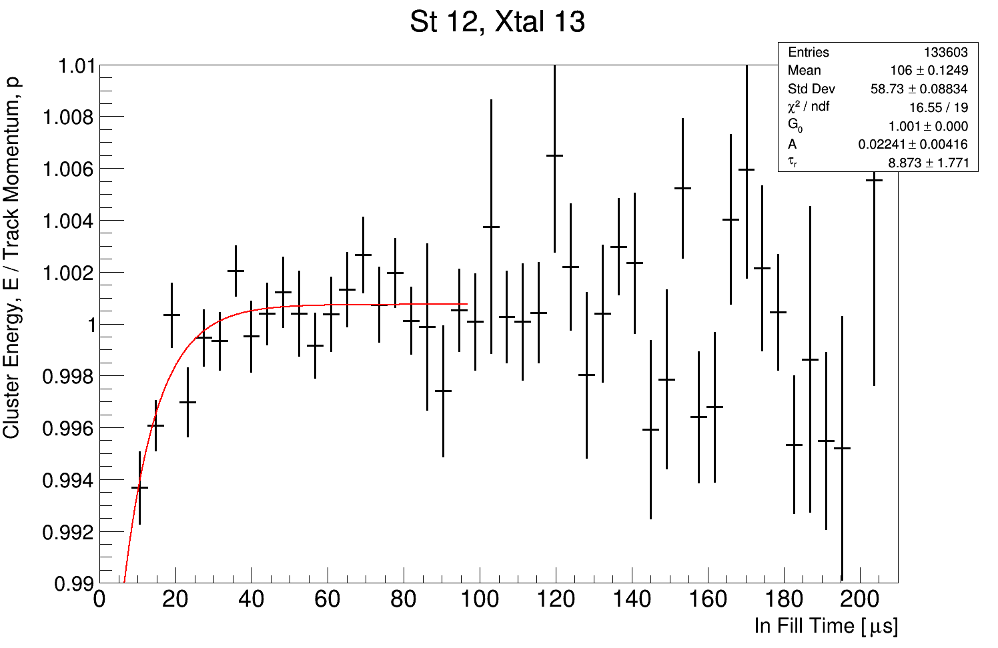
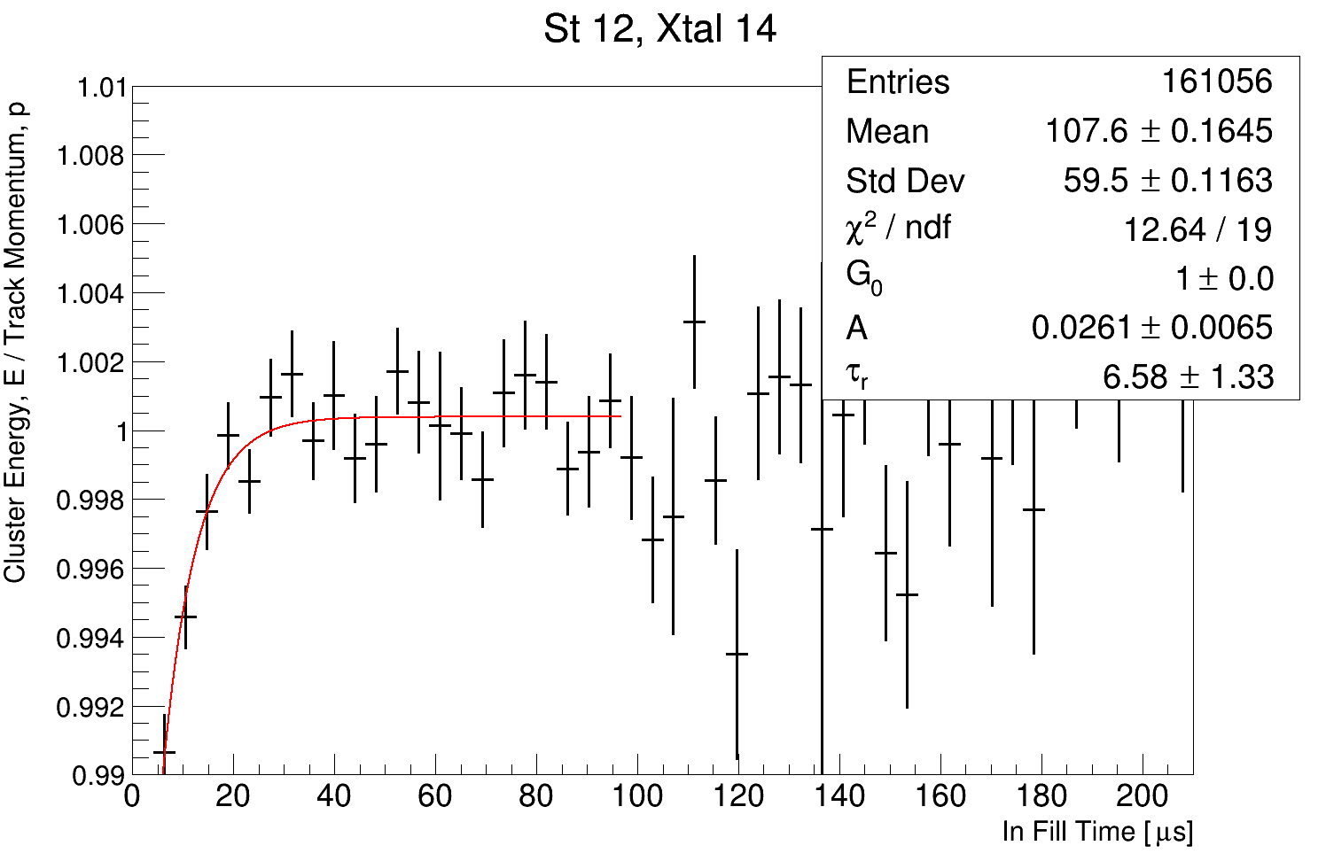
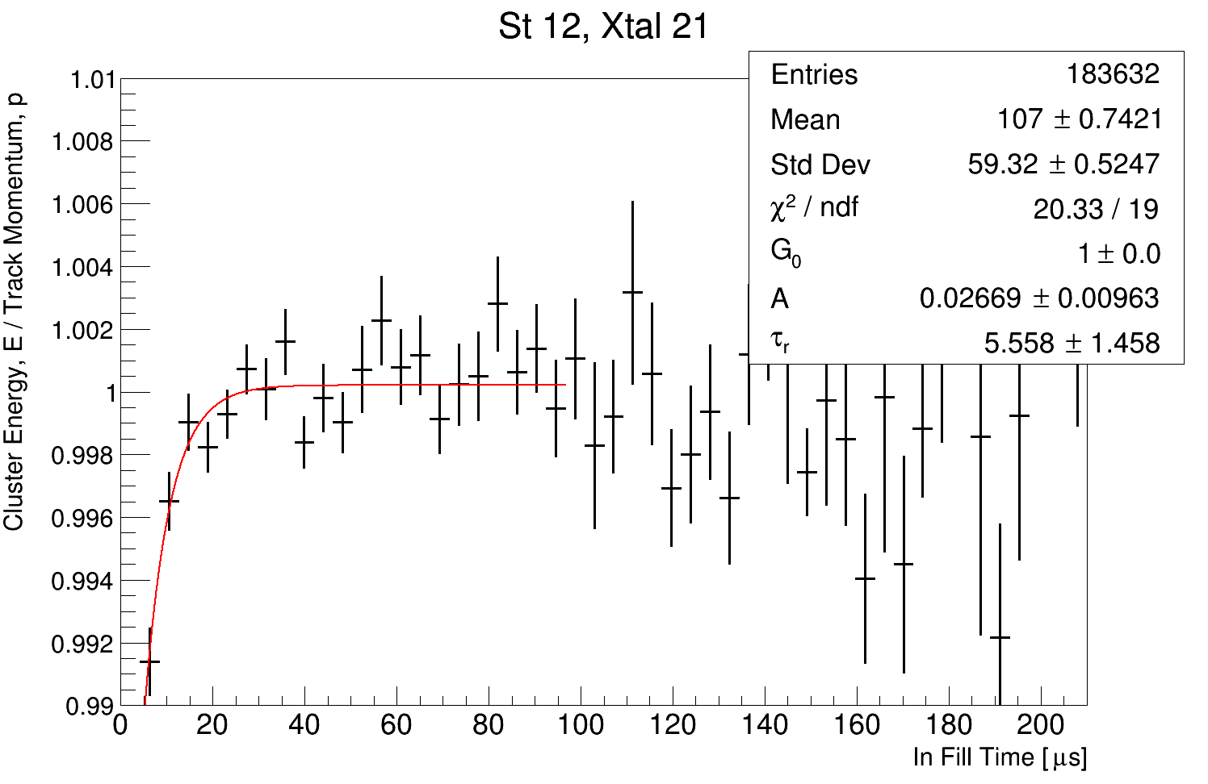
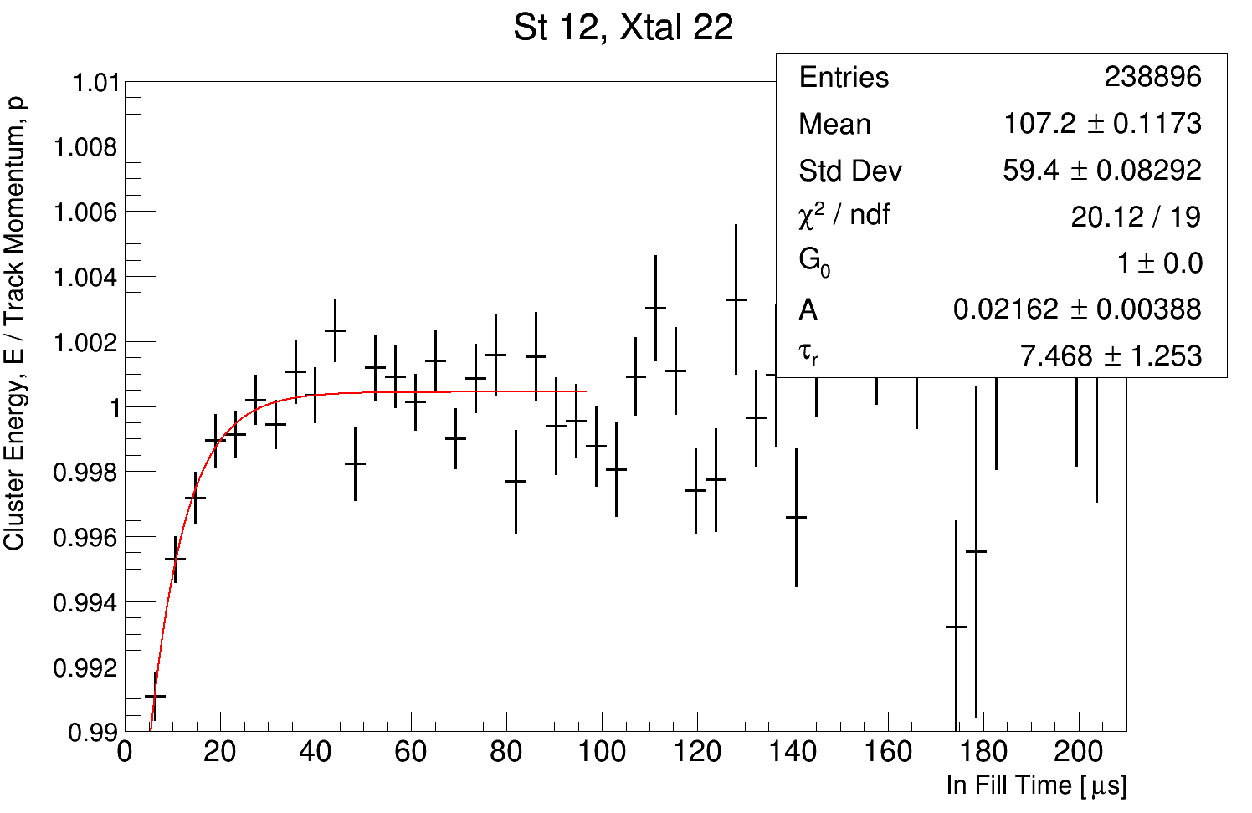
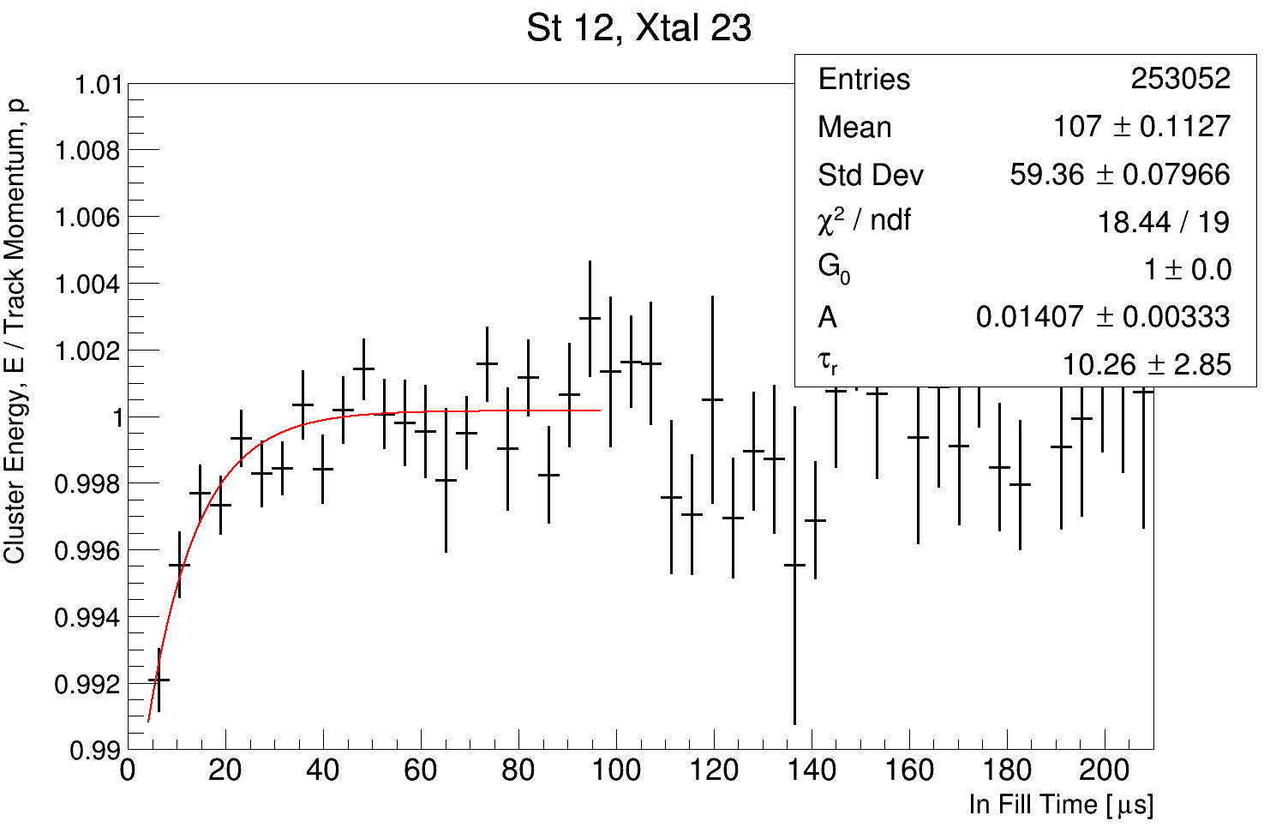
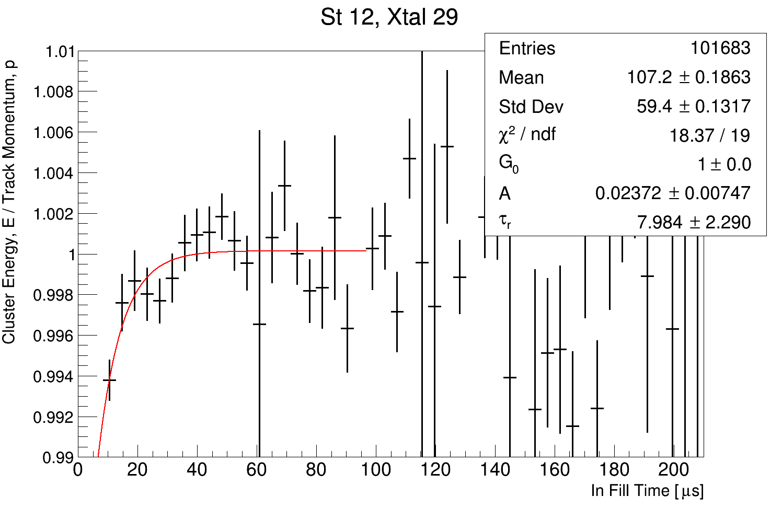
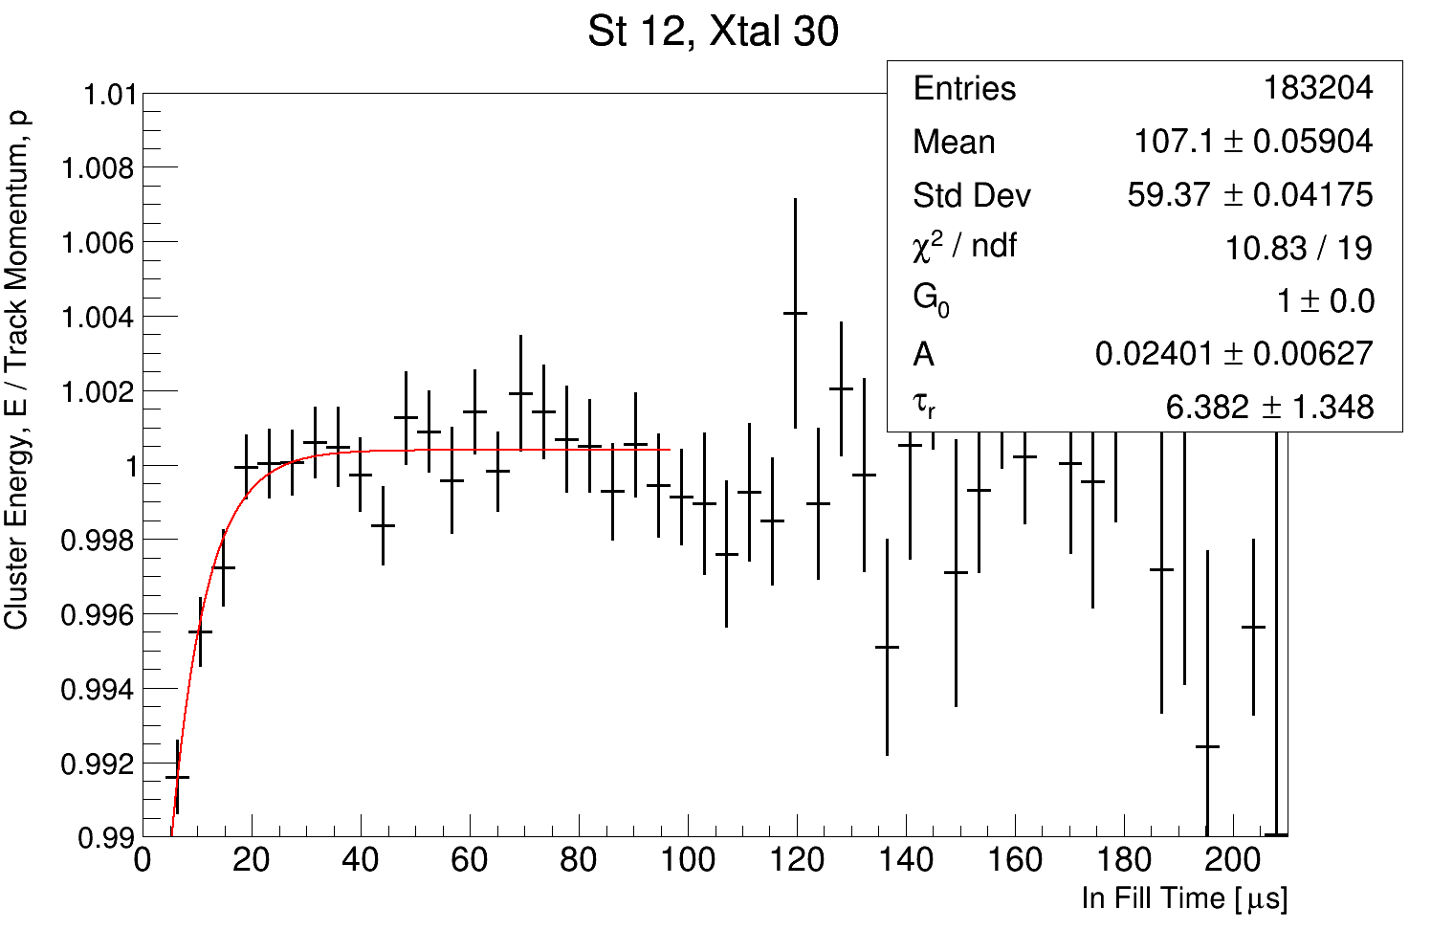
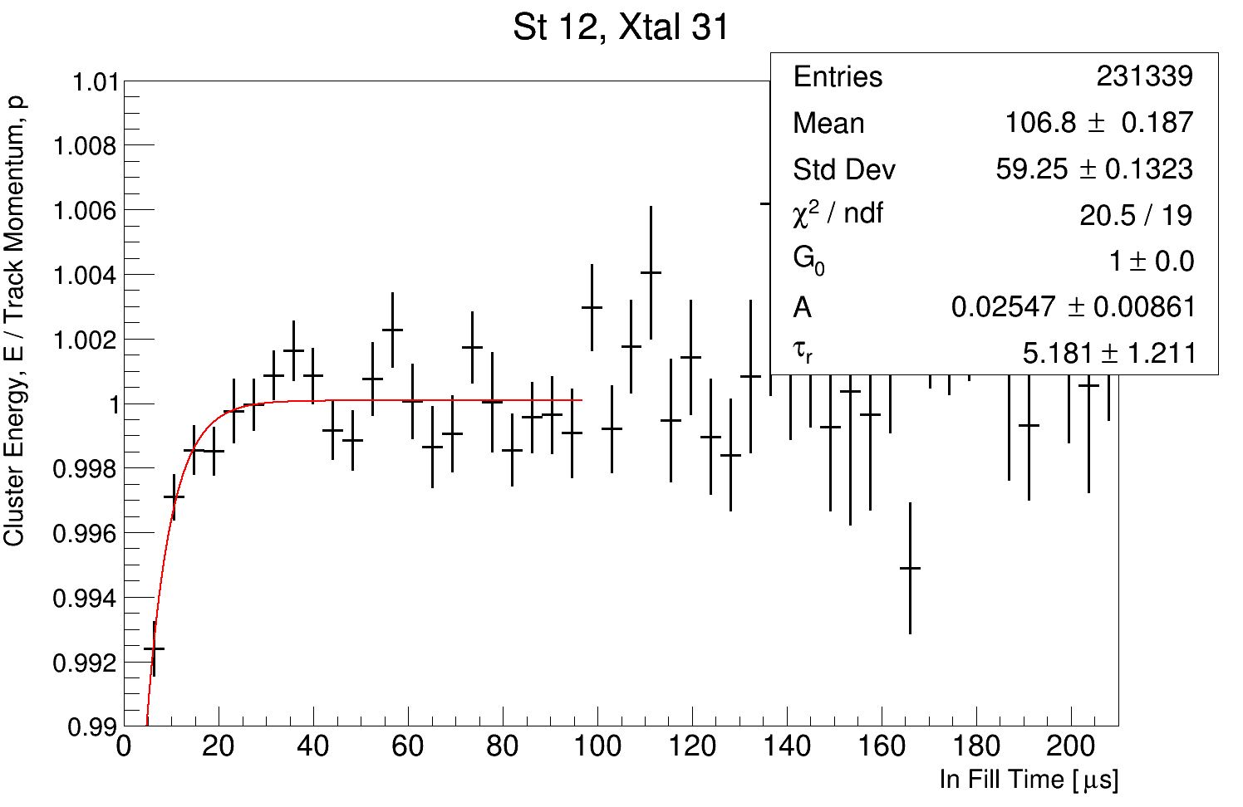
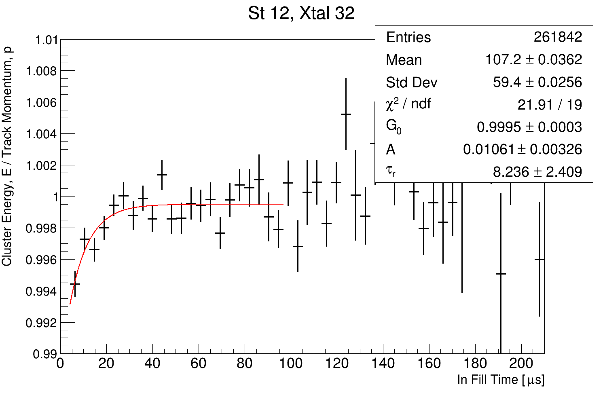
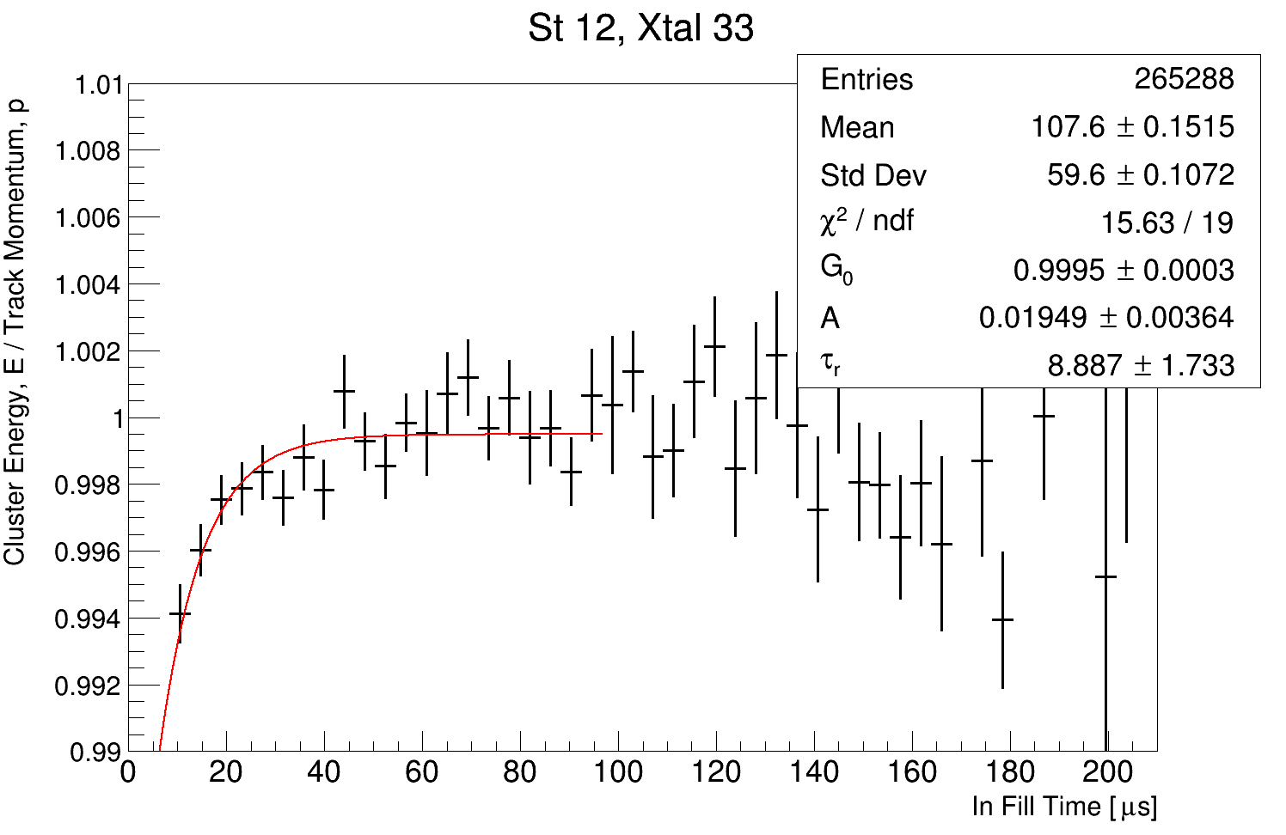
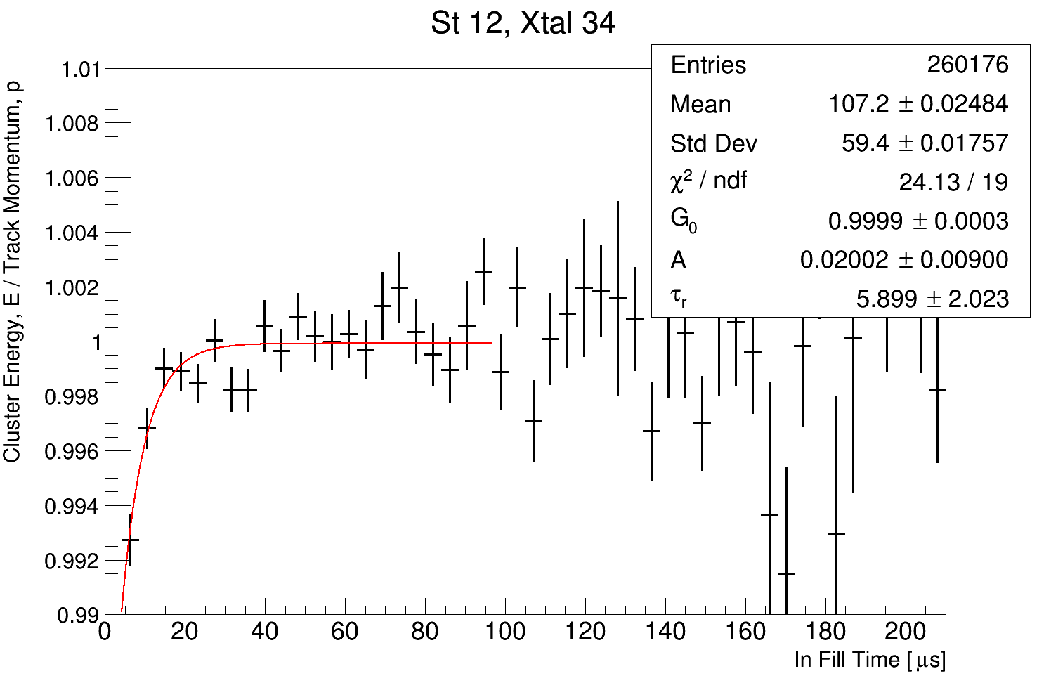
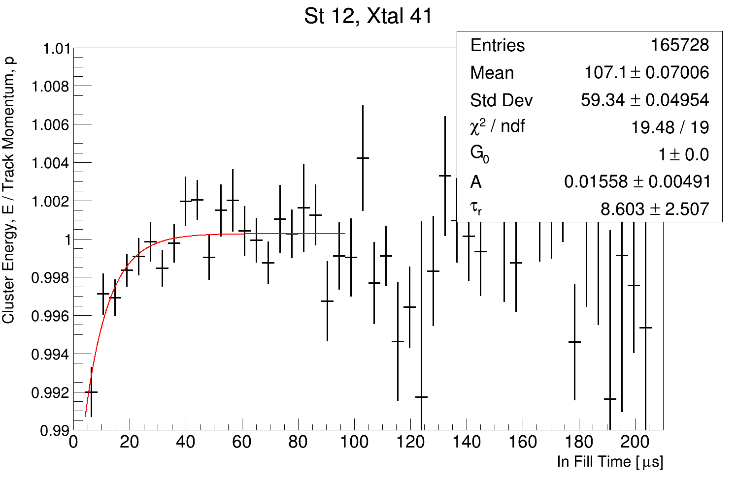
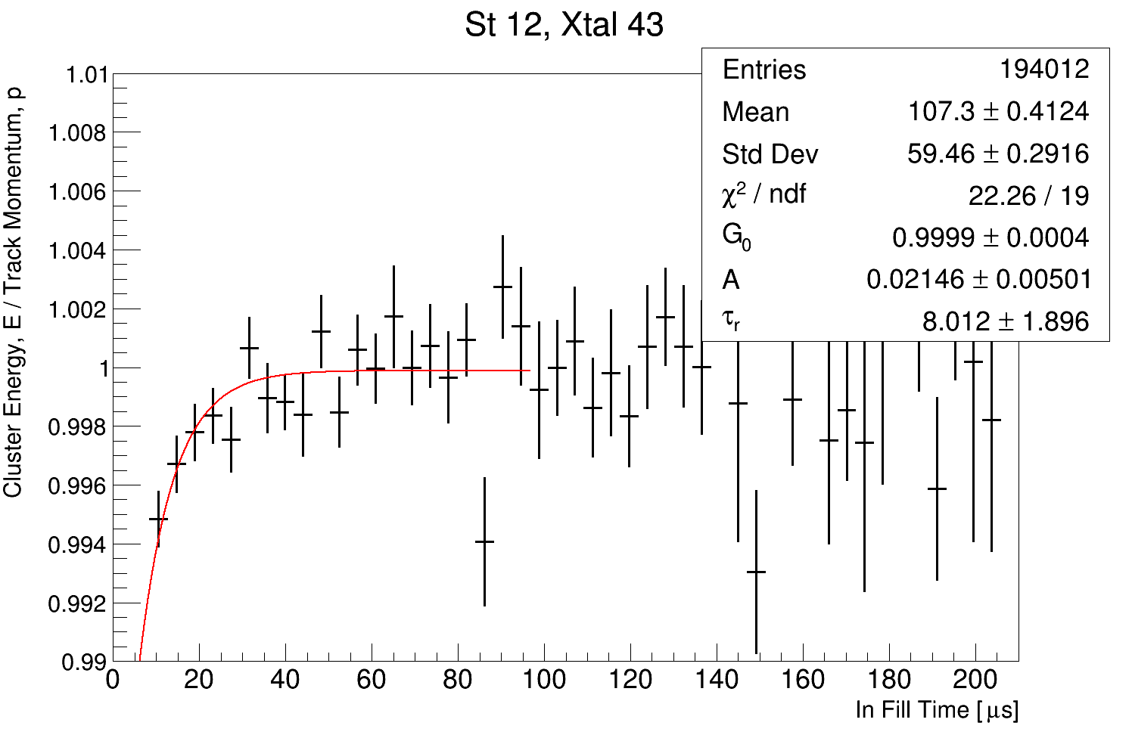
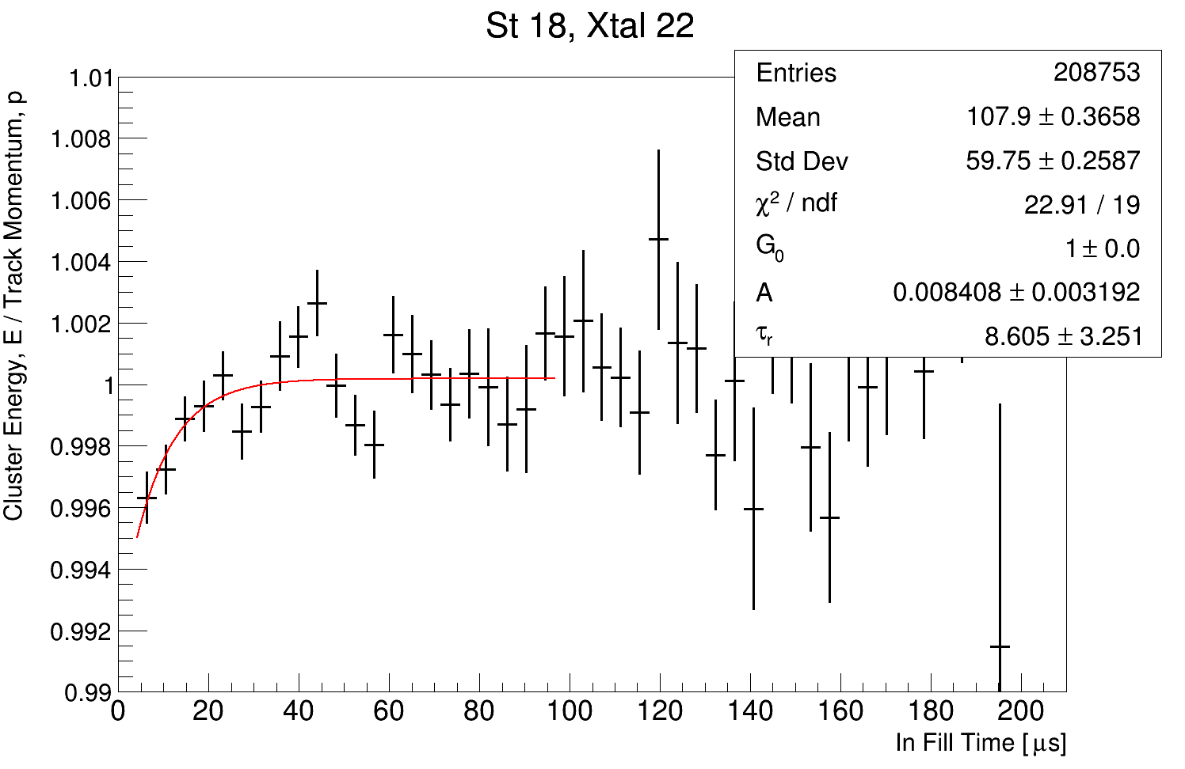

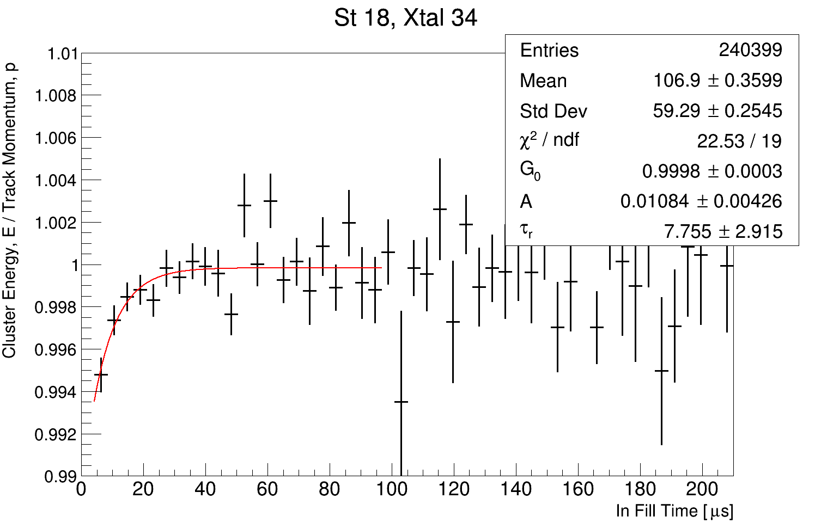
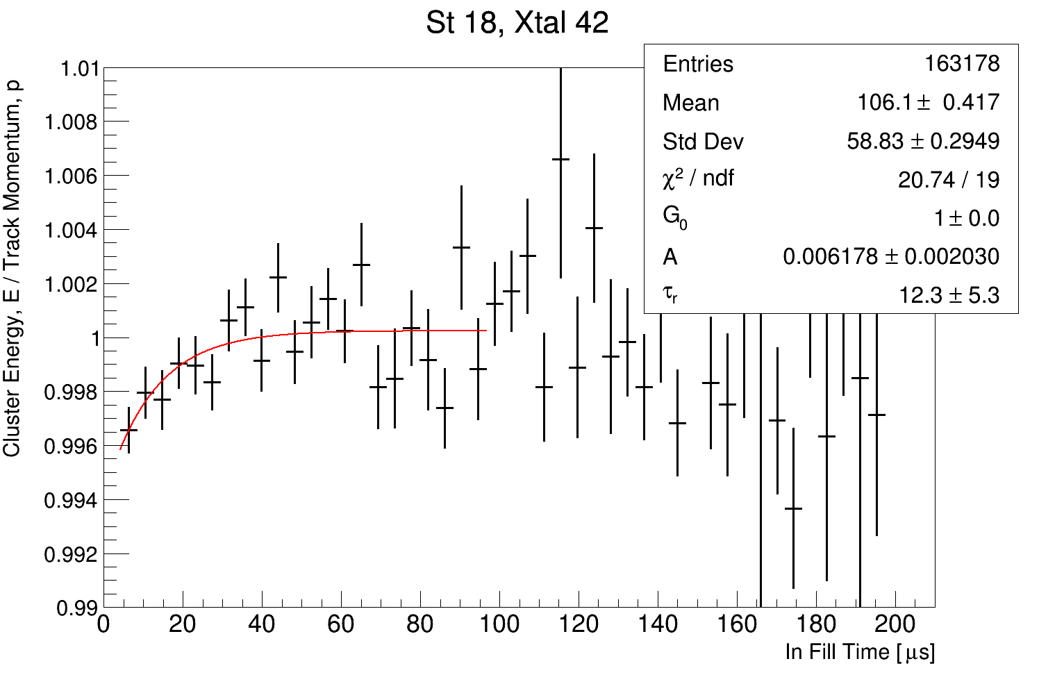
All Fits
18 crystals survive the quality cuts

